Slide 1
The Tower of Babel
Evidence and Implications for the Post-Flood World
By Stephen Lawwell
Foundations of Genesis: Part 5

Slide 2
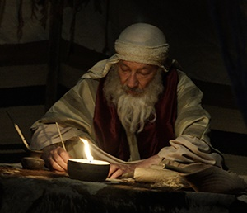
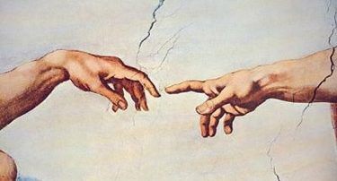
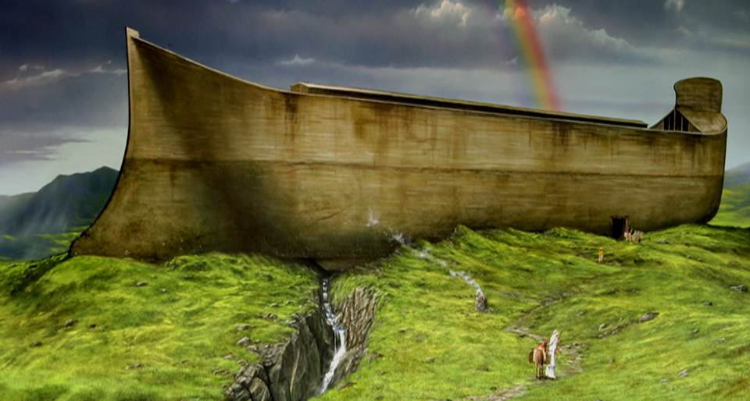
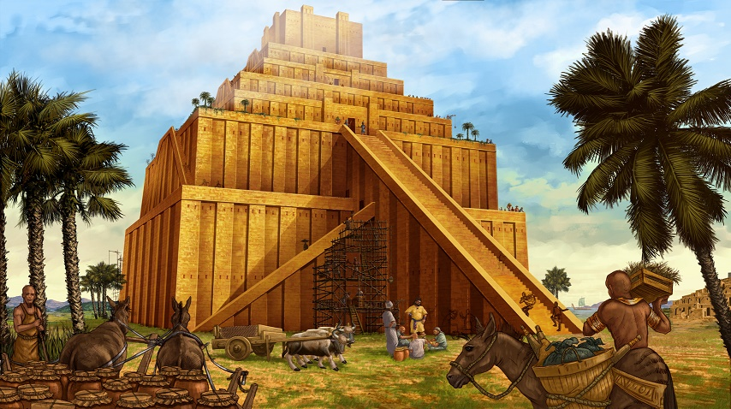

Slide 3
“If the foundations be destroyed, what can the righteous do?”
Psalm 11:3

Slide 5
“And the whole earth was of one language, and of one speech. And it came to pass, as they journeyed from the east, that they found a plain in the land of Shinar; and they dwelt there. And they said one to another, Go to, let us make brick, and burn them throughly. And they had brick for stone, and slime had they for morter.”
Genesis 11:1-9

Slide 6
“And they said, Go to, let us build us a city and a tower, whose top may reach unto heaven; and let us make us a name, lest we be scattered abroad upon the face of the whole earth. And the LORD came down to see the city and the tower, which the children of men builded. And the LORD said, Behold, the people is one, and they have all one language; and this they begin to do: and now nothing will be restrained from them, which they have imagined to do.”
Genesis 11:1-9

Slide 7
“Go to, let us go down, and there confound their language, that they may not understand one another's speech. So the LORD scattered them abroad from thence upon the face of all the earth: and they left off to build the city. Therefore is the name of it called Babel; because the LORD did there confound the language of all the earth: and from thence did the LORD scatter them abroad upon the face of all the earth.”
Genesis 11:1-9

Slide 8
The Tower of Babel
The Tower’s Location

Slide 9
“And it came to pass, as they journeyed from the east, that they found a plain in the land of Shinar; and they dwelt there.”
Genesis 11:2

Slide 10
“…as they journeyed from the east...”

Slide 11
“And Cush begat Nimrod: he began to be a mighty one in the earth… And the beginning of his kingdom was Babel, and Erech, and Accad, and Calneh, in the land of Shinar. Out of that land went forth Asshur, and builded Nineveh, and the city Rehoboth, and Calah, And Resen between Nineveh and Calah: the same is a great city.”
Genesis 10:8-12

Slide 12
Calneh?
Accad
Babel?
Erech (Uruk)

Slide 13
Shinar

Slide 14
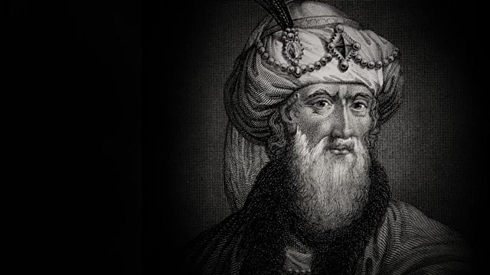
“But as to the plain of Shinar, in the country of Babylonia, Hestiaeus mentions it when he says thus: ‘Such of the priests as were saved took the sacred vessels of Jupiter Enyalius, and came to Shinar of Babylonia’”
Josephus, Antiquities of the Jews, Book I, Chapter IV, 3

Slide 15
Possible Tower Locations
Etemenanki

Slide 16
Etemenanki
(Babylon)

Slide 17
Etemenanki

Slide 18
Etemenanki
Initial construction Unknown
Destroyed by Sargon 2350 BC
Restored by Sharkalisharri 2250 BC
Restored by Esarhaddon 681-655 BC
Restored by Nebuchadnezzar II 605-562 BC
Destroyed by Xerxes 472 BC
Restored/Destroyed by Alexander 323 BC

Slide 19
Etemenanki

Slide 20
Possible Tower Locations
Etemenanki
Borsippa

Slide 21
Borsippa
(“Tongue Tower”)

Slide 22
Birs Nimrud
(“Tower of Nimrod”)

Slide 23
Borsippa

Slide 24
“A former king built the Temple of the Seven Lights of the Earth, but he did not complete its head. Since a remote time, people had abandoned it, without order expressing their words. Since that time earthquakes and lightning had dispersed its sun-dried clay; the bricks of the casing had split, and the earth of the interior had been scattered in heaps.”
Nebuchadnezzar II, Borsippa Inscription

Slide 25
“Marduk, the great lord, excited my mind to repair this building. I did not change the site, nor did I take away the foundation stone as it had been in former times. So I founded it, I made it; as it had been in ancient days, I so exalted the summit.”
Nebuchadnezzar II, Borsippa Inscription

Slide 26
Austrian archaeologists have discovered that Borsippa does indeed encase the ruins of an older tower, which had a 49,000 ft² base and an original height of 650 feet.

Slide 27
“So the LORD scattered them abroad from thence upon the face of all the earth: and they left off to build the city.”
Genesis 11:8

Slide 28
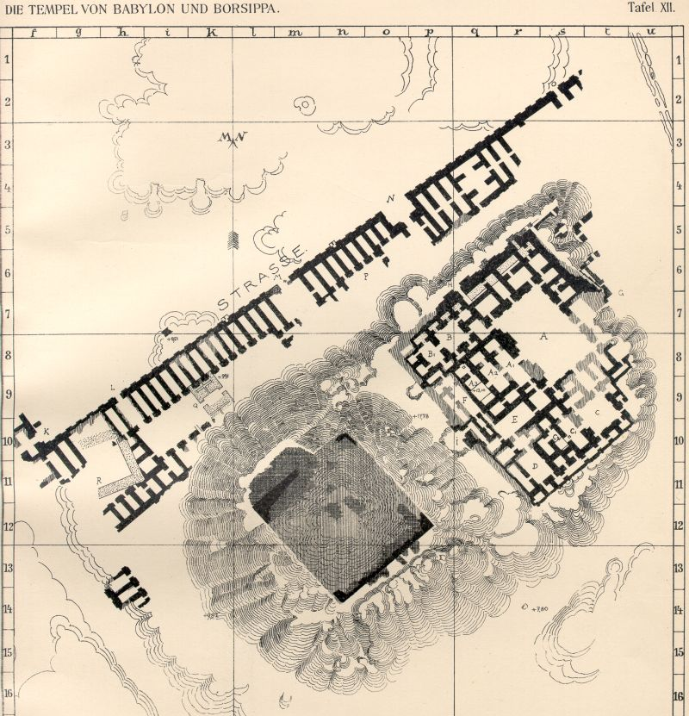
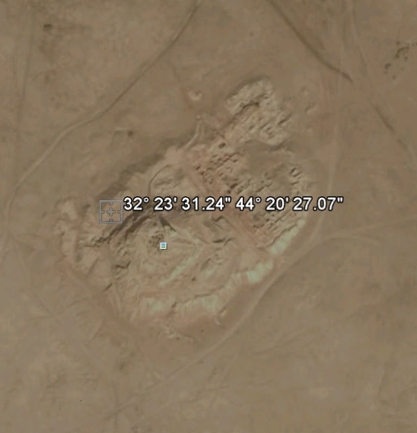

Slide 29
The Tower of Babel
The Tower’s Location
The Tower’s Purpose

Slide 30
“And they said, Go to, let us build us a city and a tower, whose top may reach unto heaven; and let us make us a name, lest we be scattered abroad upon the face of the whole earth.”
Genesis 11:4

Slide 31
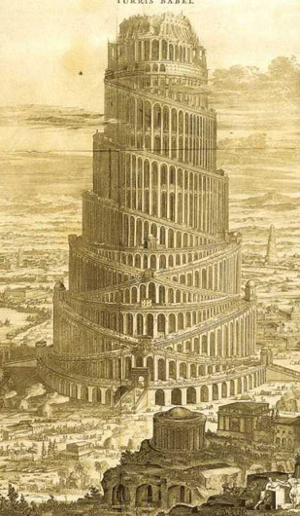
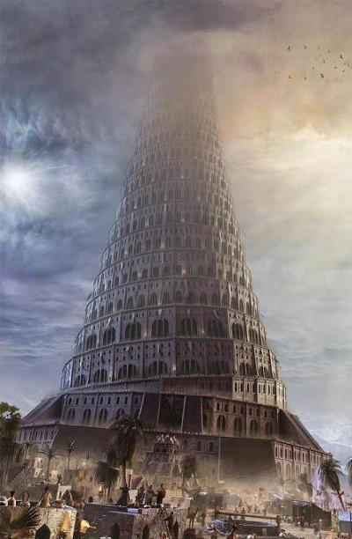
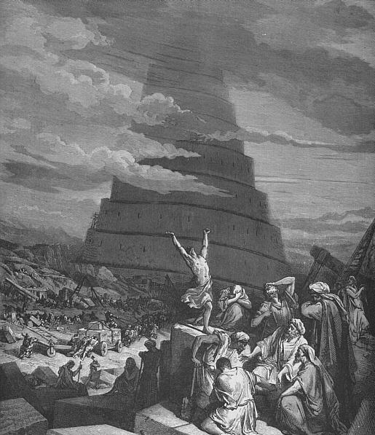

Slide 32
“Now it was Nimrod who excited them to such an affront and contempt of God… He also said he would be revenged on God, if he should have a mind to drown the world again; for that he would build a tower too high for the waters to be able to reach and that he would avenge himself on God for destroying their forefathers.’”
Josephus, Antiquities of the Jews, Book I, Chapter IV

Slide 33
“And they built it: forty and three years were they building it; its breadth was 203 bricks, and the height of a brick was the third of one; its height amounted to 5433 cubits and 2 palms, and the extent of one wall was thirteen stades and of the other thirty stades’”
1.55 miles (2.5 km)
The Book of Jubilees 10:20-21

Slide 34
Burj Khalifa (Dubai, UAE)
2,717 feet
(0.51 miles)

Slide 35
“And it came to pass, as they journeyed from the east, that they found a plain in the land of Shinar; and they dwelt there.”
Genesis 11:2

Slide 36
“…whose top may reach unto heaven; and let us make us a name, lest we be scattered abroad upon the face of the whole earth.”
~ Genesis 11:4

Slide 37
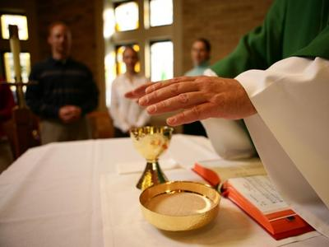
All man-made religions desire to receive honor for the works of man.

Slide 38
“And upon her forehead was a name written, MYSTERY, BABYLON THE GREAT, THE MOTHER OF HARLOTS AND ABOMINATIONS OF THE EARTH.”
Revelation 17:5

Slide 39
“And whosoever shall exalt himself shall be abased; and he that shall humble himself shall be exalted.”
Matthew 23:12

Slide 40
“...God resisteth the proud, but giveth grace unto the humble.”
James 4:6

Slide 41
The Tower of Babel
The Tower’s Purpose
The Tower’s Location
God’s Response

Slide 42
“And the LORD came down to see the city and the tower, which the children of men builded. And the LORD said, Behold, the people is one, and they have all one language; and this they begin to do: and now nothing will be restrained from them, which they have imagined to do. Go to, let us go down, and there confound their language, that they may not understand one another's speech. ”
Genesis 11:5-9

Slide 43
“So the LORD scattered them abroad from thence upon the face of all the earth: and they left off to build the city. Therefore is the name of it called Babel; because the LORD did there confound the language of all the earth: and from thence did the LORD scatter them abroad upon the face of all the earth.”
Genesis 11:5-9

Slide 44
God’s way of making the people of Babel separate was more effective than if He had built a wall between them, yet gentle.

Slide 45
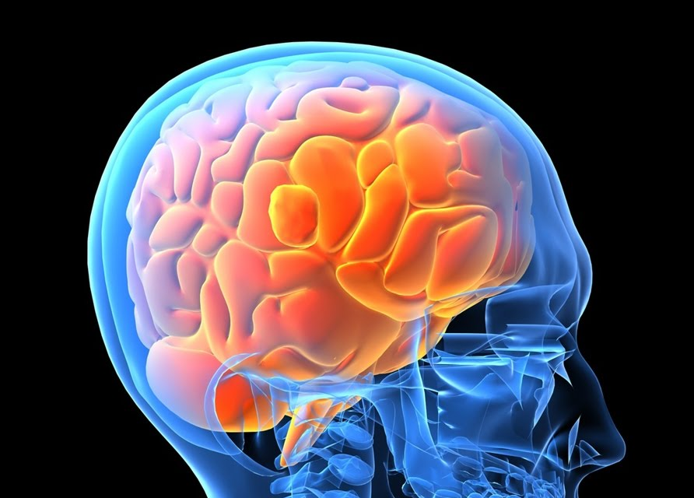
DOG (English)
INU (Japanese)

Slide 46
There are ~7,000 languages, but linguists have been able to associate these with
94 proto-languages.

Slide 49
These proto-languages represent the parent languages that were formed at the Tower of Babel.

Slide 50
The Tower of Babel
The Tower’s Purpose
The Tower’s Location
God’s Response
Biological Side-Effects

Slide 51
Not only were the languages set within each group that migrated from Babel, but also the genetic information within their bodies.

Slide 55
Whatever genetic traits (i.e. skin color, eye shape, hair texture, etc.) that were found in the majority of the population would have become more prominent and fixed as the years passed.

Slide 56
“Races”

Slide 57
“Races”
Genetically limited and biologically diverse groups of people.

Slide 58
Skin color and eye shape only account for 0.012% of all genetic differences.

Slide 59
Melanin

Slide 60
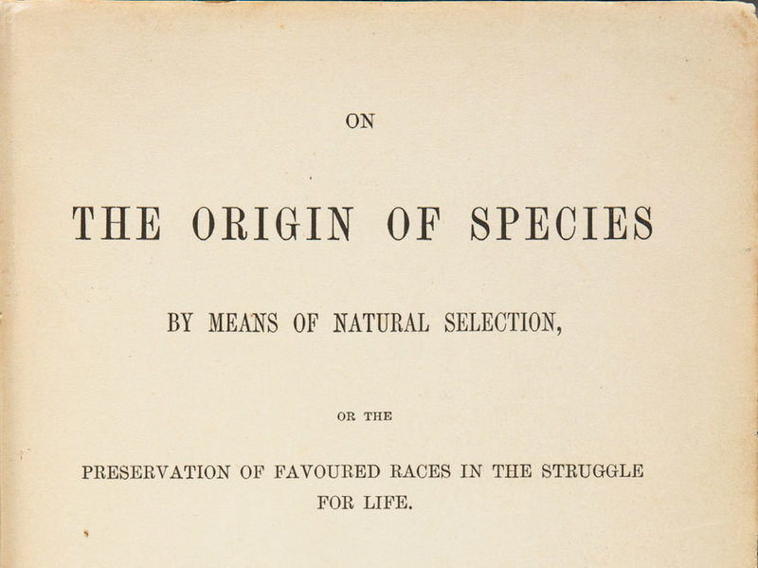

Slide 61
“And hath made of one blood all nations of men for to dwell on all the face of the earth, and hath determined the times before appointed, and the bounds of their habitation;”
Acts 17:26

Slide 62
Common Misunderstandings on “Race”
The result of Cain’s Mark

Slide 63
“And Cain talked with Abel his brother: and it came to pass, when they were in the field, that Cain rose up against Abel his brother, and slew him.”
~ Genesis 4:8

Slide 64
“And now art thou cursed from the earth, which hath opened her mouth to receive thy brother's blood from thy hand; When thou tillest the ground, it shall not henceforth yield unto thee her strength; a fugitive and a vagabond shalt thou be in the earth.”
Genesis 4:11-16

Slide 65
“And Cain said unto the LORD, My punishment is greater than I can bear. Behold, thou hast driven me out this day from the face of the earth; and from thy face shall I be hid; and I shall be a fugitive and a vagabond in the earth; and it shall come to pass, that every one that findeth me shall slay me.”
Genesis 4:11-16

Slide 66
“And the LORD said unto him, Therefore whosoever slayeth Cain, vengeance shall be taken on him sevenfold. And the LORD set a mark upon Cain, lest any finding him should kill him. And Cain went out from the presence of the LORD…”
Genesis 4:11-16

Slide 67
The Mark of Cain
Translated from the Hebrew “oth” (beacon or signal).
Placed upon Cain for his own benefit and protection, not as a punishment.
Did not pass to his children.

Slide 68
Common Misunderstandings on “Race”
The result of Cain’s Mark
The result of Ham’s Curse

Slide 69
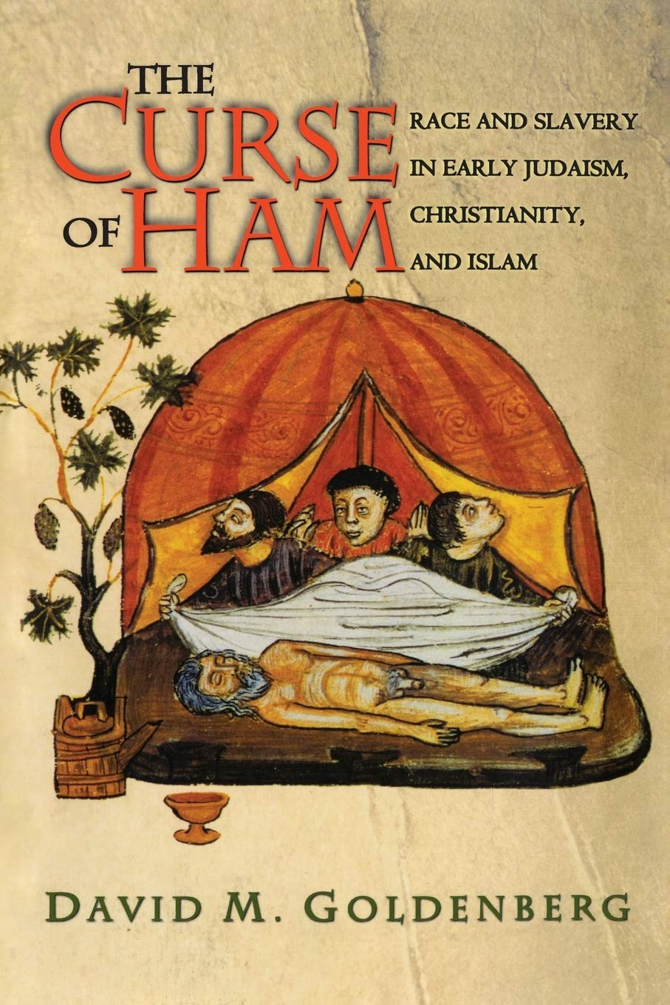
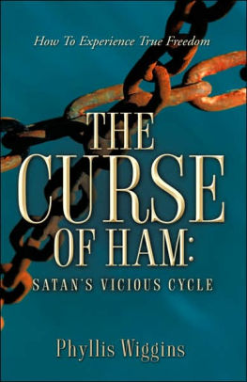
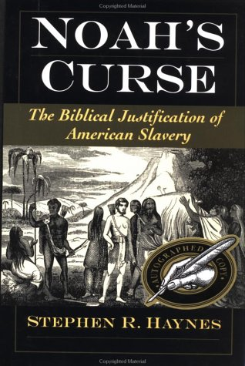

Slide 70
“And Ham, the father of Canaan, saw the nakedness of his father, and told his two brethren without. And Shem and Japheth took a garment, and laid it upon both their shoulders, and went backward, and covered the nakedness of their father; and their faces were backward, and they saw not their father’s nakedness.”
Genesis 9:22-27

Slide 71
“And Noah awoke from his wine, and knew what his younger son had done unto him. And he said, Cursed be Canaan; a servant of servants shall he be unto his brethren. And he said, Blessed be the LORD God of Shem; and Canaan shall be his servant. God shall enlarge Japheth, and he shall dwell in the tents of Shem; and Canaan shall be his servant.”
Genesis 9:22-27

Slide 72
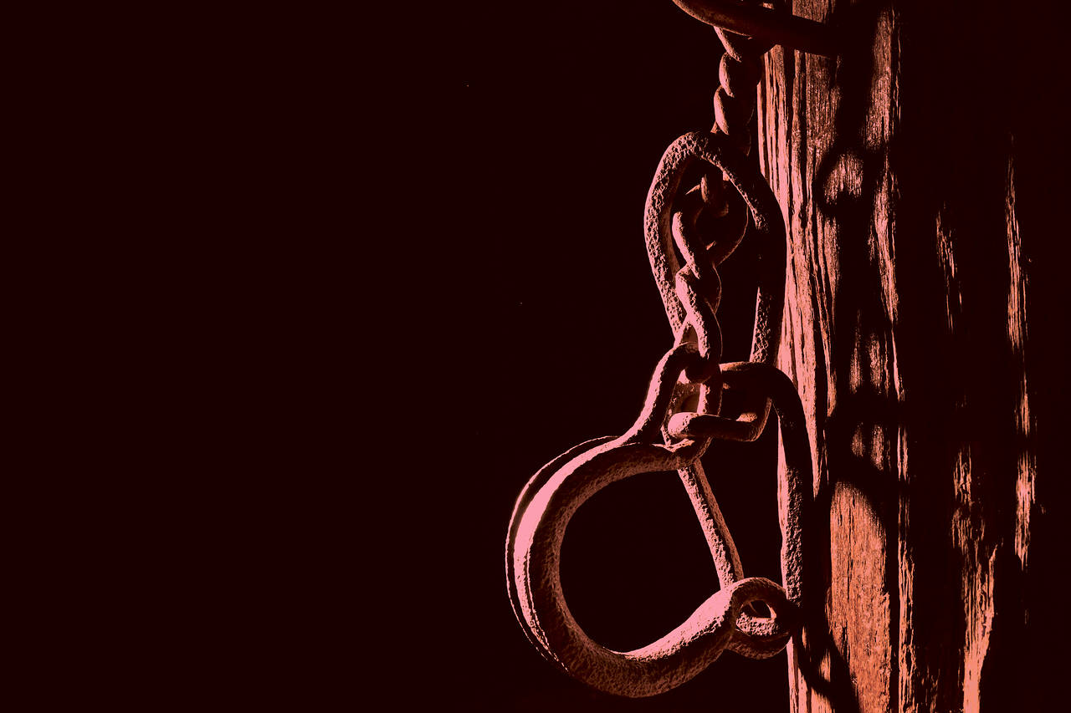
A “servant” is not necessarily a “slave”.

Slide 73
“Let this mind be in you, which was also in Christ Jesus: Who, being in the form of God, thought it not robbery to be equal with God: But made himself of no reputation, and took upon him the form of a servant, and was made in the likeness of men: And being found in fashion as a man, he humbled himself, and became obedient unto death, even the death of the cross.”
Philippians 2:5-8

Slide 74
Canaan was the father of the Canaanite people, not the ancestors of the groups that settled in Africa.

Slide 77
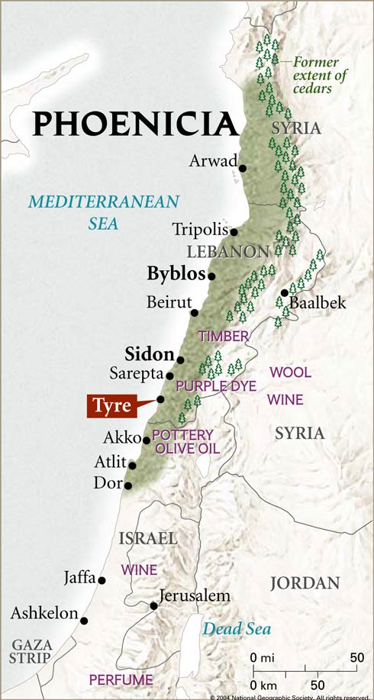
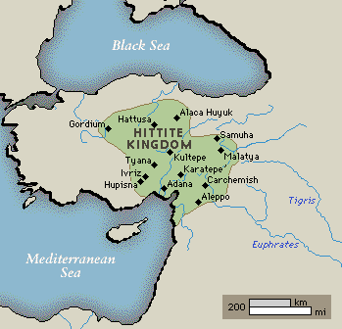

Slide 78
“And the border of the Canaanites was from Sidon, as thou comest to Gerar, unto Gaza; as thou goest, unto Sodom, and Gomorrah, and Admah, and Zeboim, even unto Lasha.”
Genesis 10:19

Slide 79
At the foot of the Cross, there is level ground for all groups of people.

Slide 80
“There is neither Jew nor Greek, there is neither bond nor free, there is neither male nor female: for ye are all one in Christ Jesus.”
~ Galatians 3:28

Slide 81
The Tower of Babel
The Tower’s Purpose
The Tower’s Location
God’s Response
Biological Side-Effects
Post-Babel Society

Slide 83
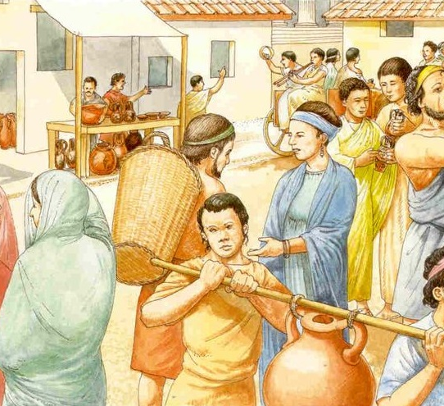
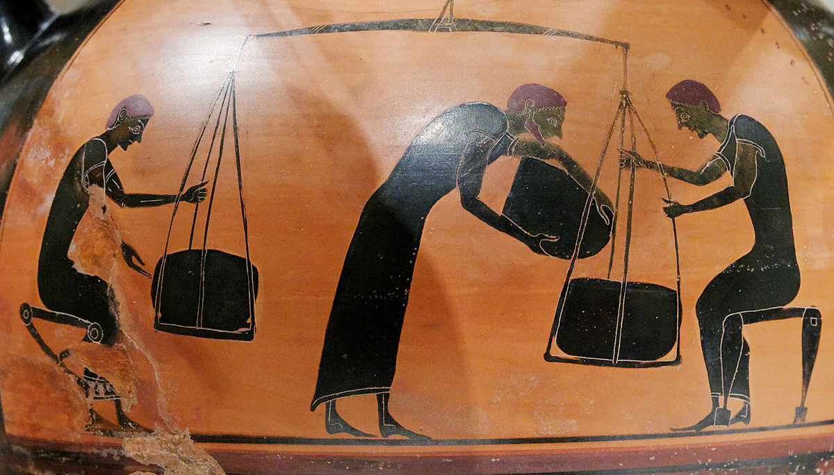
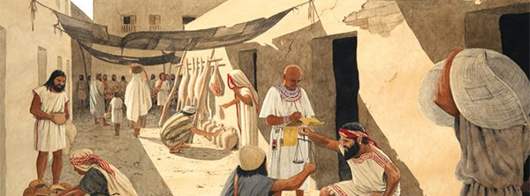

Slide 85
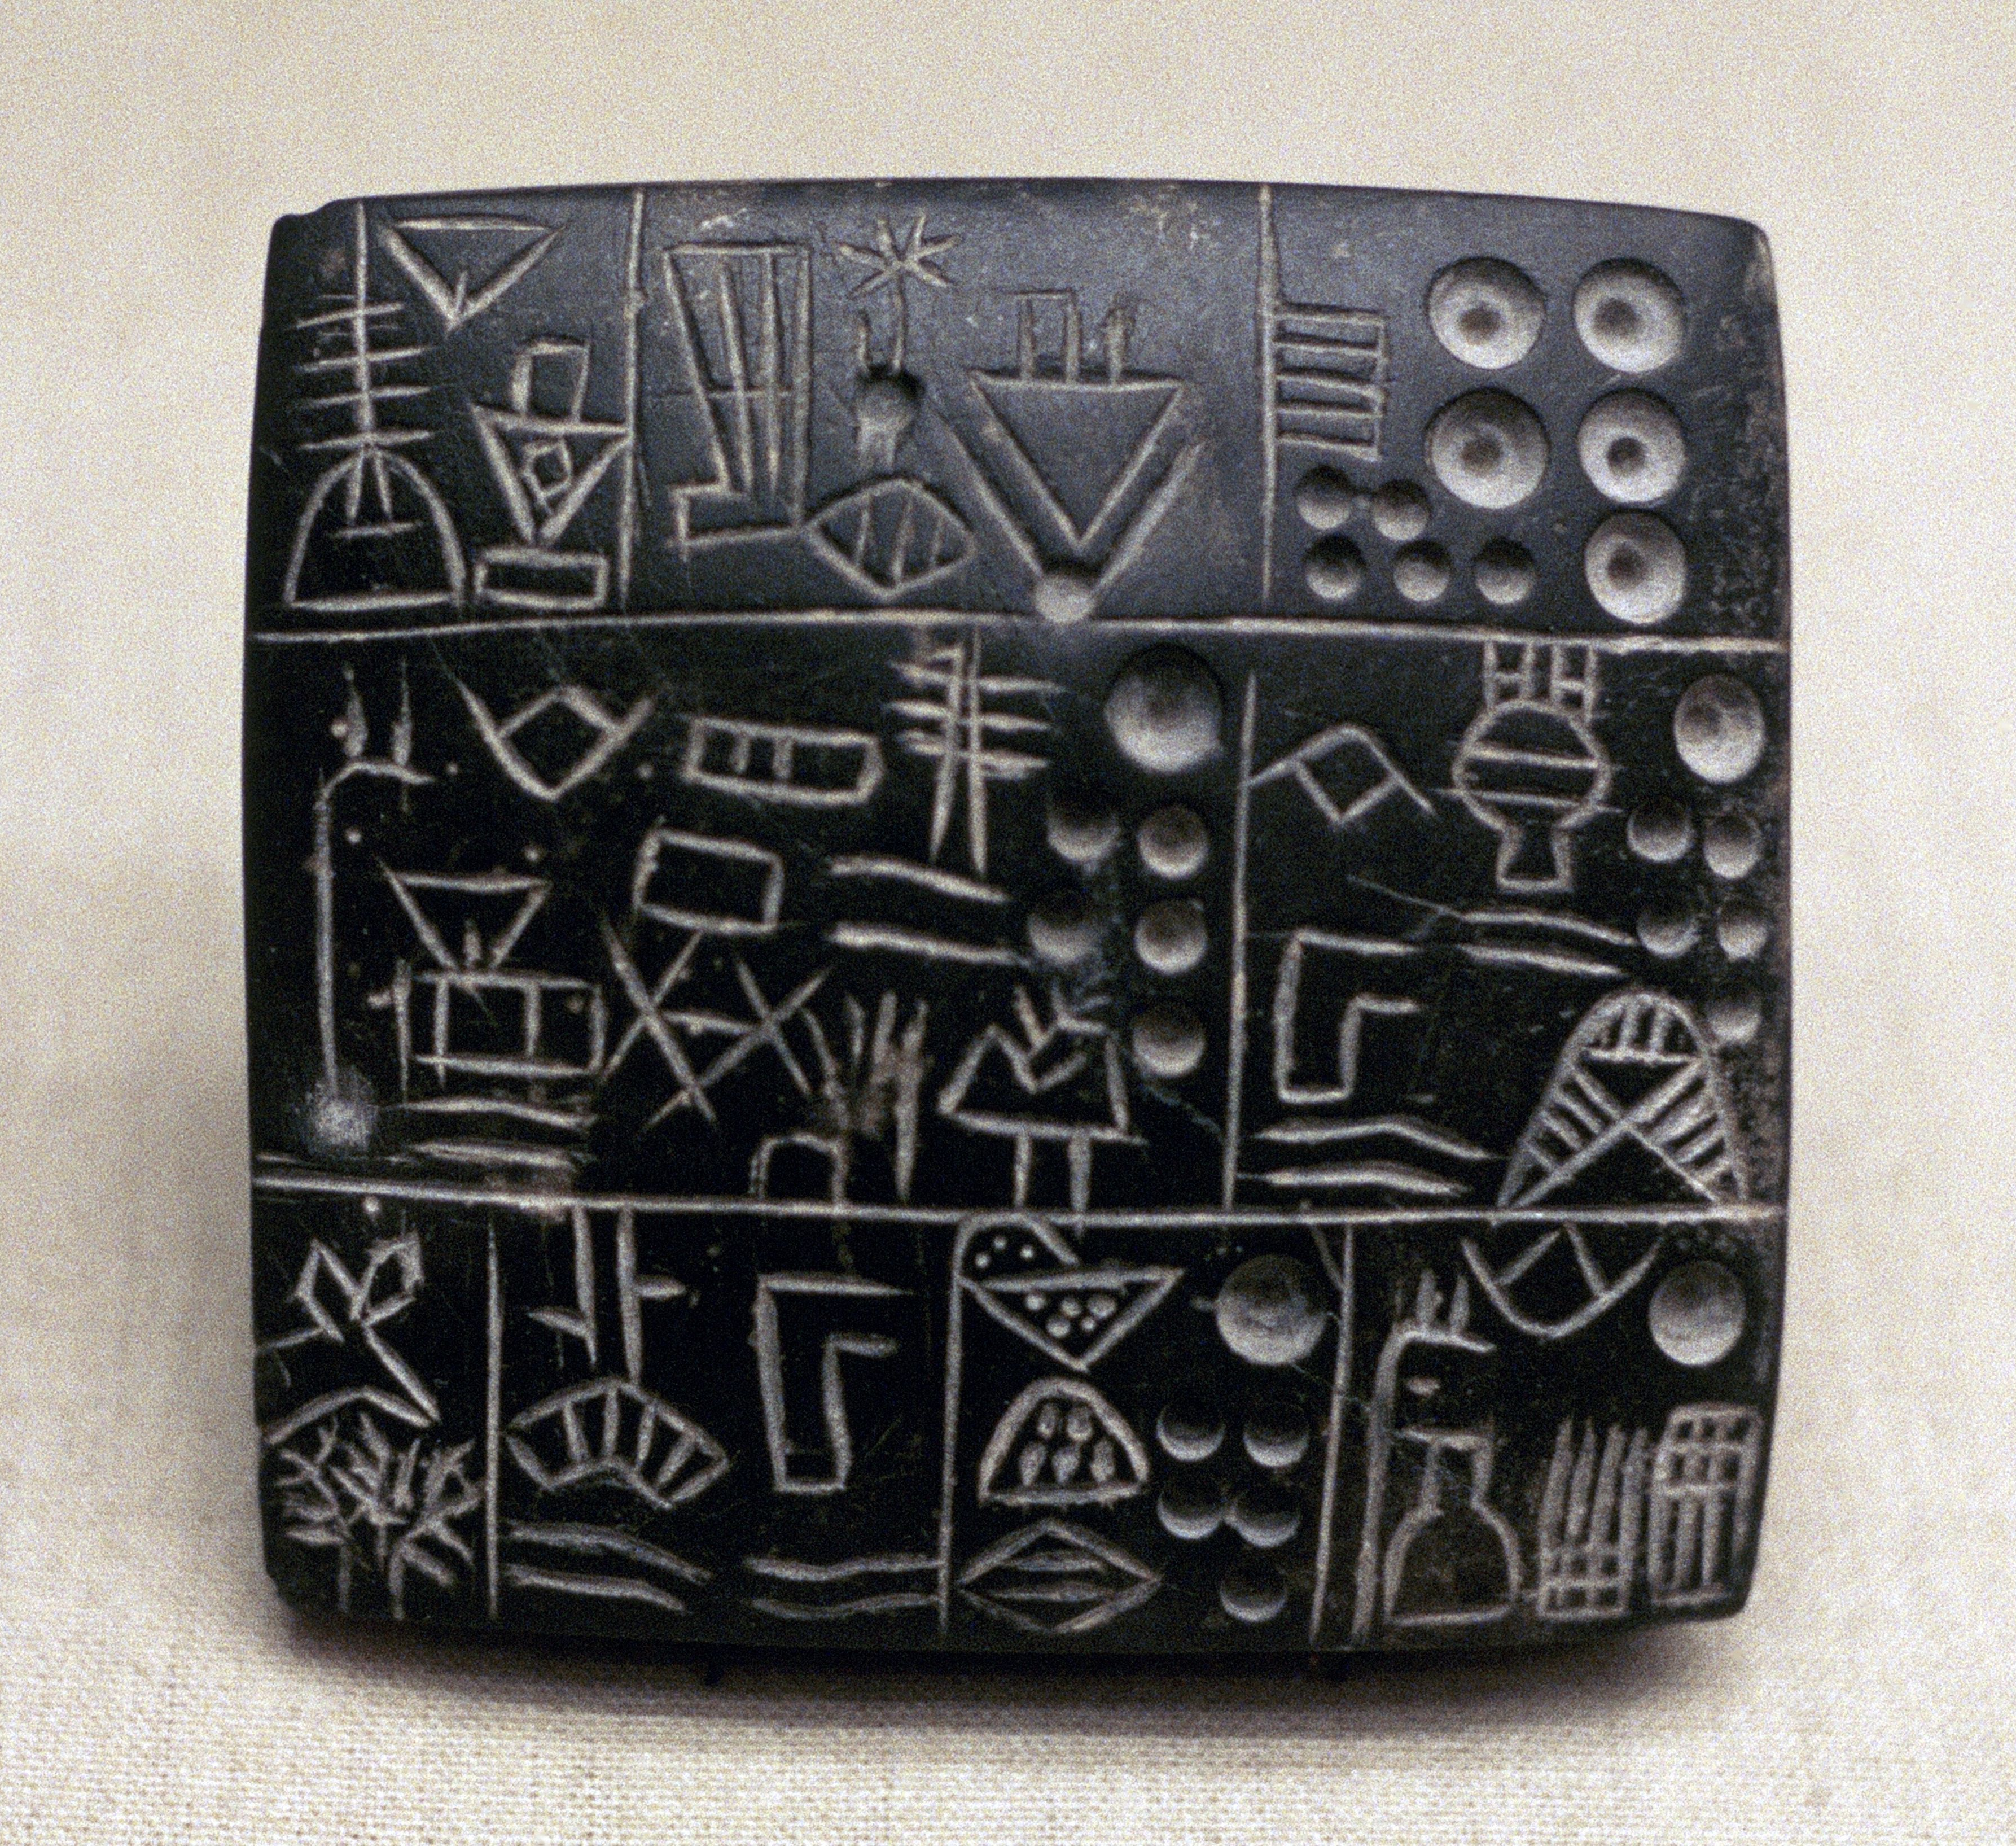
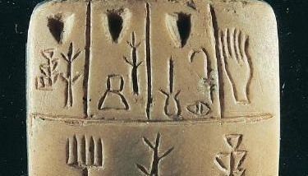
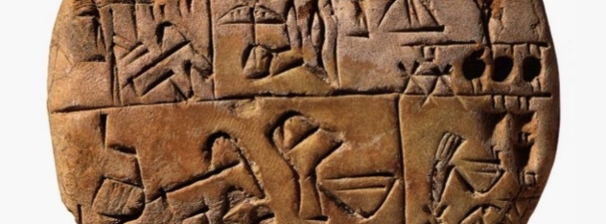
Proto-Cuneiform

Slide 86
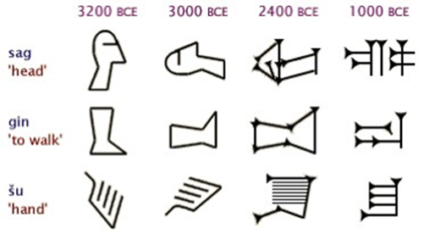

Slide 87
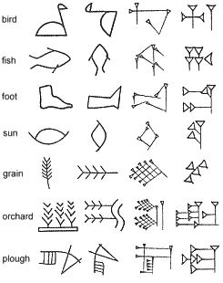

Slide 88
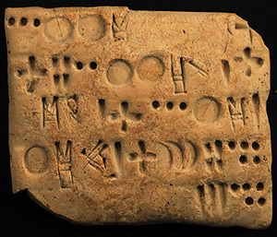
Elamite

Slide 89
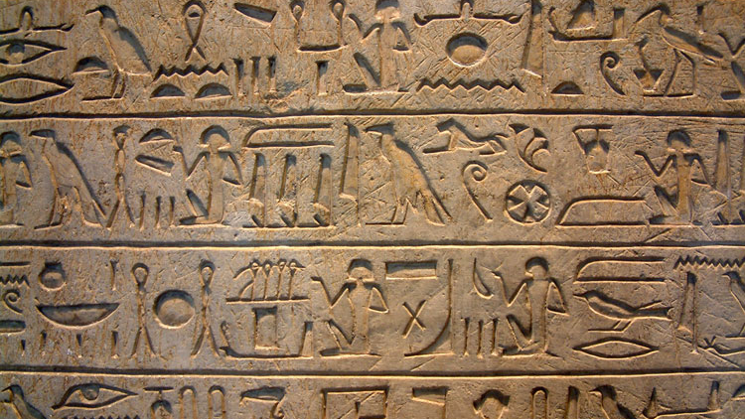
Egyptian

Slide 90
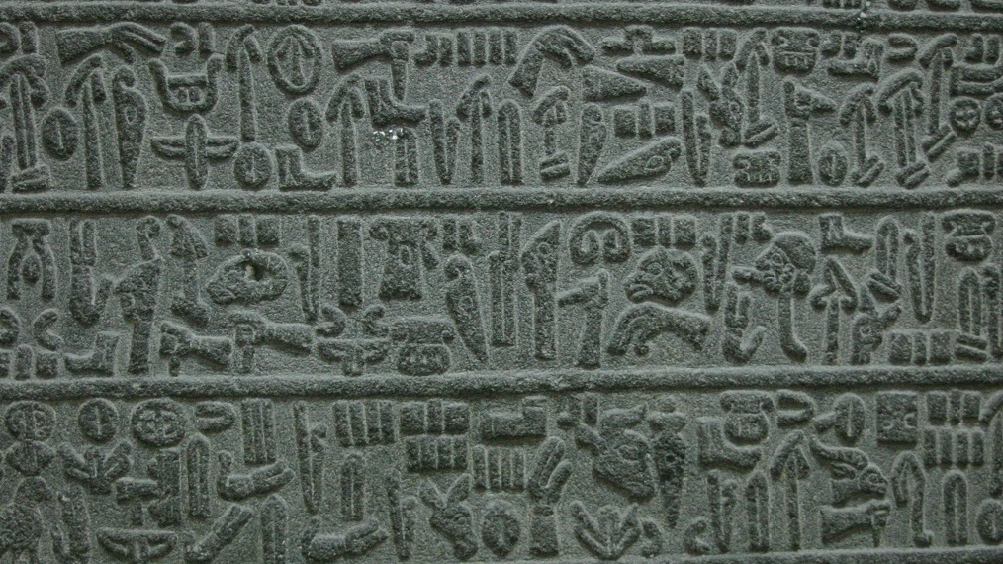
Hittite
(Luwian)

Slide 91
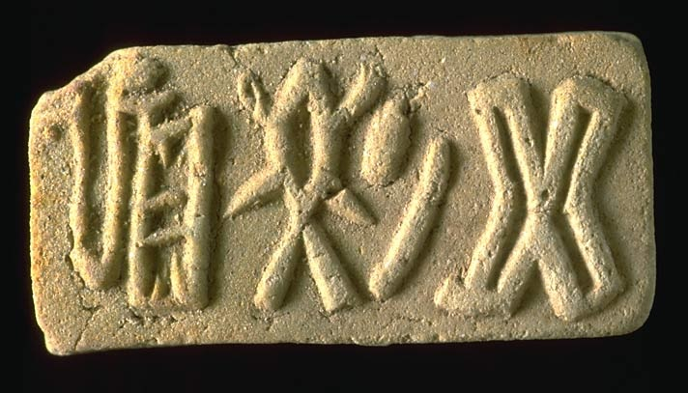
Harrapan
(Indus)

Slide 92
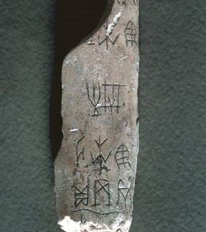
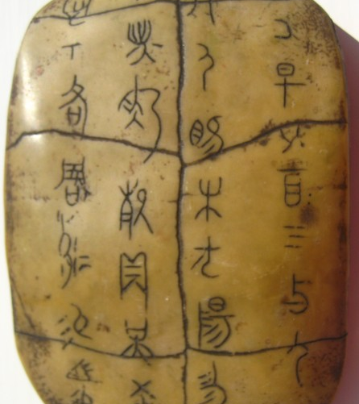
Chinese Oracle Bone Script

Slide 93
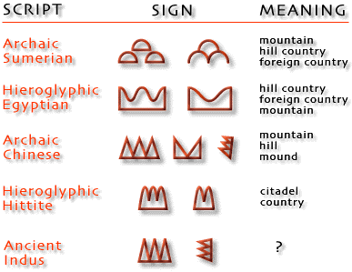

Slide 95
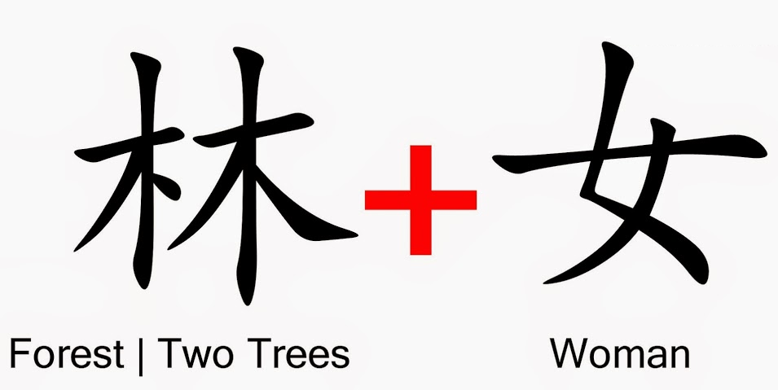

Slide 97
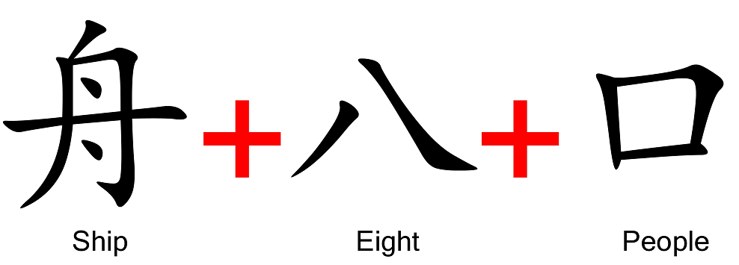

Slide 99
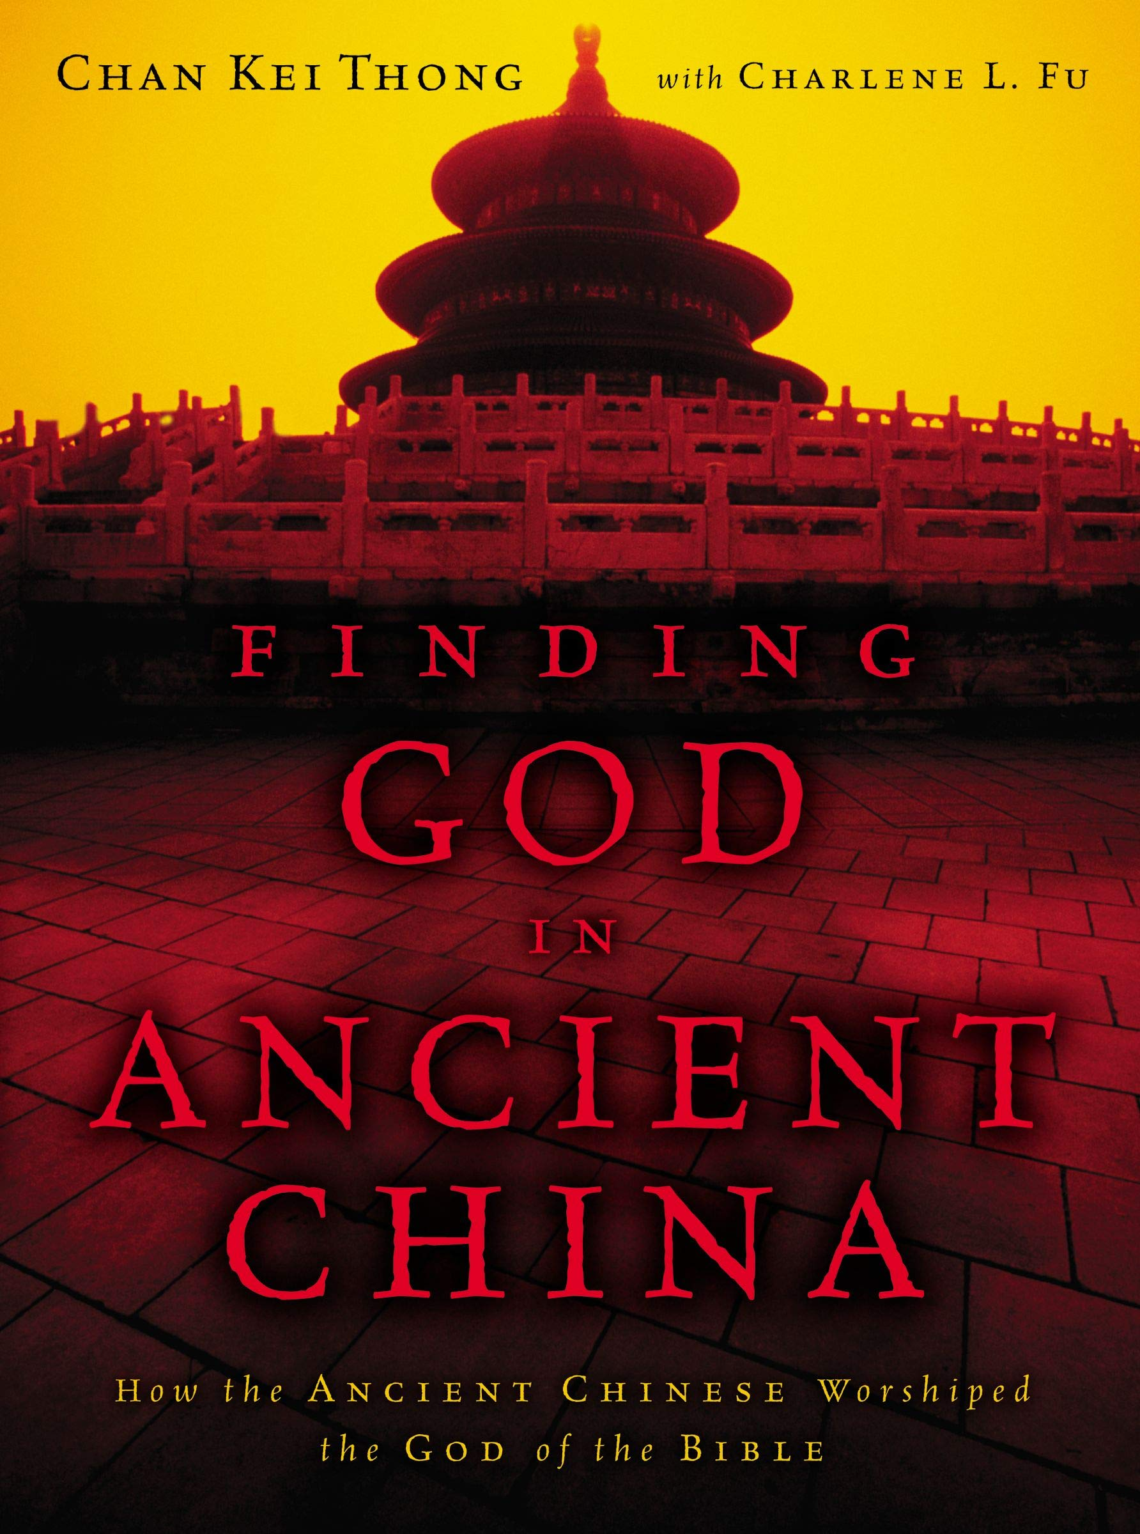
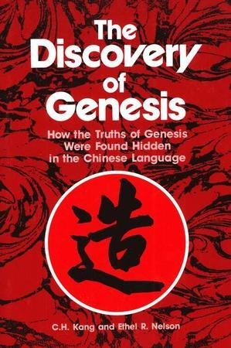

Slide 100
Although the languages and geography changed for those at Babel, their spiritual worldview in many cases did not.

Slide 101
“…whose top may reach unto heaven; and let us make us a name…”
~ Genesis 11:4

Slide 102
Step Pyramid of Djoser
(Saqqara, Egypt)

Slide 103
Chichen Itza
(Mayan)

Slide 104
Candi Sukuh
(Java, Indonesia)

Slide 105
Hellinikon Pyramid
(Greek)

Slide 106
Xian, China

Slide 107
Xian, China

Slide 108
“Jesus saith unto him, I am the way, the truth, and the life: no man cometh unto the Father, but by me.”
~ John 14:6

Slide 109
The Tower of Babel
Evidence and Implications for the Post-Flood World
By Stephen Lawwell
Foundations of Genesis: Part 5

