Slide 1
The Garden of Eden
Paradise and the Pre-Flood World
By Stephen Lawwell
Foundations of Genesis: Part 2

Slide 2
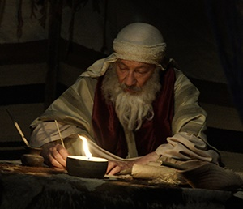
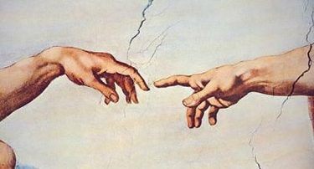
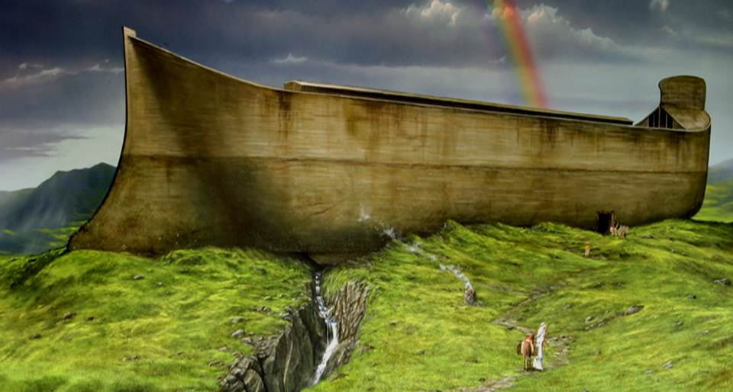
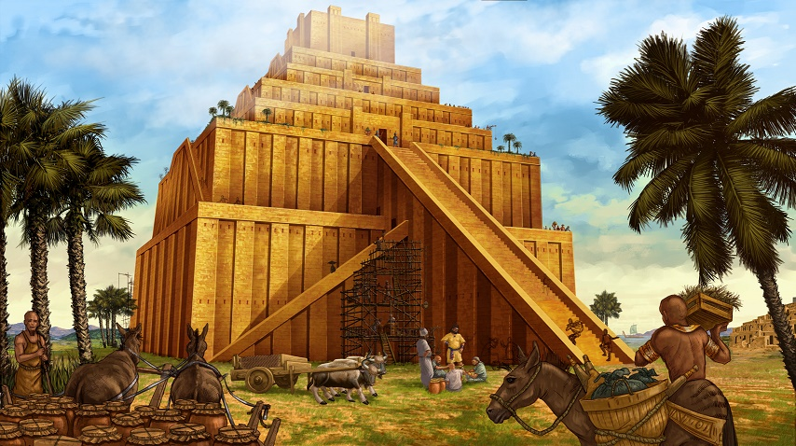

Slide 3
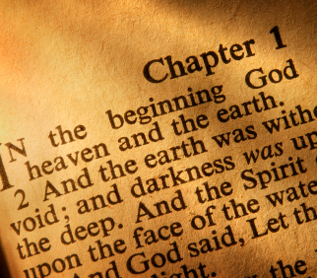
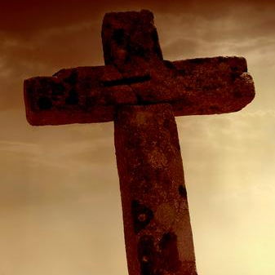

Slide 4
“If the foundations be destroyed, what can the righteous do?”
Psalm 11:3

Slide 5
Paradise and the Pre-Flood World
The Garden of Eden

Slide 6
“And the LORD God planted a garden eastward in Eden; and there he put the man whom he had formed. And out of the ground made the LORD God to grow every tree that is pleasant to the sight, and good for food; the tree of life also in the midst of the garden, and the tree of knowledge of good and evil.”
Genesis 2:8-9

Slide 7
Where is the Garden of Eden Located?

Slide 9
“And a river went out of Eden to water the garden; and from thence it was parted, and became into four heads. The name of the first is Pison: that is it which compasseth the whole land of Havilah, where there is gold; And the gold of that land is good: there is bdellium and the onyx stone.”
Genesis 2:10-14

Slide 10
“And the name of the second river is Gihon: the same is it that compasseth the whole land of Ethiopia. And the name of the third river is Hiddekel: that is it which goeth toward the east of Assyria. And the fourth river is Euphrates.”
Genesis 2:10-14

Slide 11
Do These Rivers Still Exist?
Pison – Unknown?
Gihon – Nile?
Hiddekel – Tigris?
Euphrates – Euphrates?

Slide 12
The Rivers of Eden…
Were Fed Differently

Slide 13
“And a river went out of Eden to water the garden; and from thence it was parted, and became into four heads.”
Genesis 2:10

Slide 14
Genesis 2:10-14
Pison
Euphrates
Gihon
Hiddekel

Slide 15
Tigris
Euphrates
Nile

Slide 16
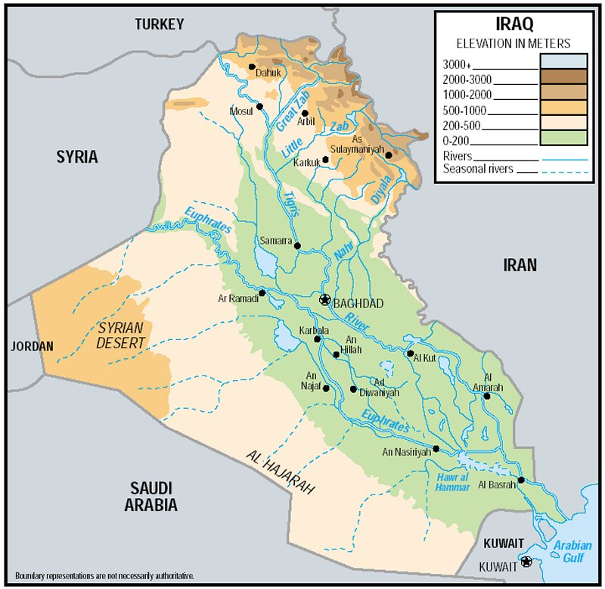
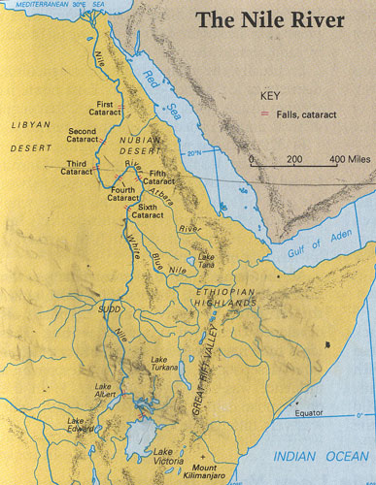

Slide 17
“Thou hast been in Eden the garden of God… Thou art the anointed cherub that covereth; and I have set thee so: thou wast upon the holy mountain of God…”
Ezekiel 28:13-14

Slide 18
The Rivers of Eden…
Were Fed Differently
Flowed Differently

Slide 19
“And the name of the second river is Gihon: the same is it that compasseth the whole land of Ethiopia. And the name of the third river is Hiddekel: that is it which goeth toward the east of Assyria. And the fourth river is Euphrates.”
Genesis 2:13-14

Slide 20
The Rivers of Eden…
Were Fed Differently
Flowed Differently
Were Destroyed

Slide 21
“Whereby the world that then was, being overflowed with water, perished:”
~ 2 Peter 3:6

Slide 22
Memphis, Egypt
Waterloo, Belgium
Paris, France
Naples, Italy
Memphis, TN
Waterloo, NY
Paris, TN
Naples, FL

Slide 23
Paradise and the Pre-Flood World
The Garden of Eden
The Plan of God

Slide 24
Eden
“Pleasure, delight”

Slide 25
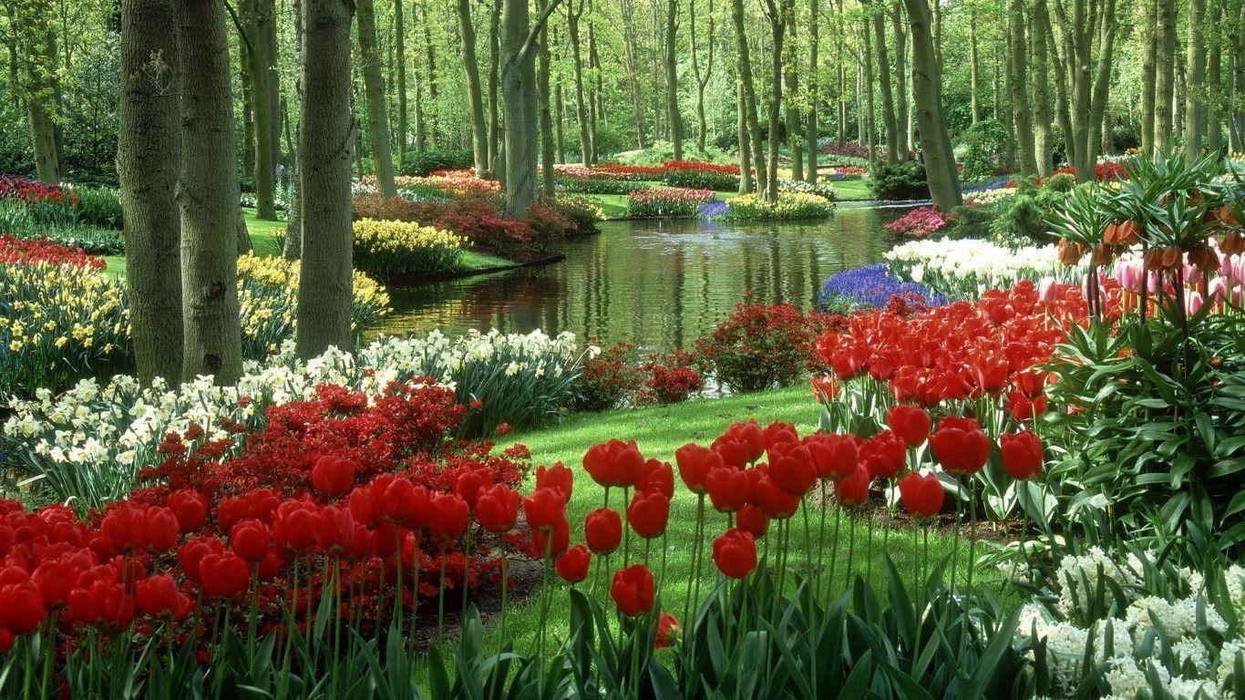

Slide 26
“And out of the ground made the LORD God to grow every tree that is pleasant to the sight, and good for food...”
Genesis 2:9

Slide 27
“And the LORD God said, It is not good that the man should be alone; I will make him an help meet for him… but for Adam there was not found an help meet for him. And the LORD God caused a deep sleep to fall upon Adam, and he slept: and he took one of his ribs, and closed up the flesh instead thereof...”
Genesis 2:18-23

Slide 28
“And the rib, which the LORD God had taken from man, made he a woman, and brought her unto the man. And Adam said, This is now bone of my bones, and flesh of my flesh: she shall be called Woman, because she was taken out of Man.”
Genesis 2:18-23

Slide 29
The Brides of Adam and Christ
Adam’s bride came from his sacrifice.

Slide 30
“Husbands, love your wives, even as Christ also loved the church, and gave himself for it;”
Ephesians 5:25

Slide 31
The Brides of Adam and Christ
Adam’s bride came from his sacrifice.
Adam’s bride came from his side.

Slide 32
“But one of the soldiers with a spear pierced his side, and forthwith came there out blood and water.”
Ephesians 5:25

Slide 33
Men do not have one less rib than women!

Slide 34
The Brides of Adam and Christ
Adam’s bride came from his sacrifice.
Adam’s bride came from his side.
Adam’s bride was his flesh and bone.

Slide 35
“For we are members of his body, of his flesh, and of his bones.”
Ephesians 5:30

Slide 36
The Brides of Adam and Christ
Adam’s bride came from his sacrifice.
Adam’s bride came from his side.
Adam’s bride was his flesh and bone.
Adam’s bride was brought to him.

Slide 37
“Then we which are alive and remain shall be caught up together with them in the clouds, to meet the Lord in the air: and so shall we ever be with the Lord.”
1 Thessalonians 4:17

Slide 38
“Let us be glad and rejoice, and give honour to him: for the marriage of the Lamb is come, and his wife hath made herself ready.”
Revelation 19:7

Slide 39
Paradise and the Pre-Flood World
The Garden of Eden
The Plan of God
The Fall of Man

Slide 40
Satan’s Creation
Satan’s Fall
Seth’s Birth
1
2
3
4
5
6
130 years
Adam and Eve’s Fall

Slide 41
“And God blessed them, and God said unto them, Be fruitful, and multiply, and replenish the earth…”
Genesis 1:28

Slide 42
“Now the serpent was more subtil than any beast of the field which the LORD God had made.”
Genesis 3:1

Slide 43
“Thou hast been in Eden the garden of God; every precious stone was thy covering…Thou art the anointed cherub that covereth… Thou wast perfect in thy ways from the day that thou wast created, till iniquity was found in thee.”
Ezekiel 28:13-15

Slide 44
“How art thou fallen from heaven, O Lucifer, son of the morning!… For thou hast said in thine heart, I will ascend into heaven, I will exalt my throne above the stars of God: I will sit also upon the mount of the congregation, in the sides of the north: I will ascend above the heights of the clouds; I will be like the most High.”
Isaiah 14:12-14

Slide 45
Three Lies of Satan
Doubt God’s Word

Slide 46
“And he said unto the woman, Yea, hath God said, Ye shall not eat of every tree of the garden?”
~ Genesis 3:1

Slide 47
“And the woman said unto the serpent, We may eat of the fruit of the trees of the garden: But of the fruit of the tree which is in the midst of the garden, God hath said, Ye shall not eat of it, neither shall ye touch it, lest ye die.”
Genesis 3:2-3

Slide 48
Three Lies of Satan
Doubt God’s Word
Deny God’s Truth

Slide 49
“And the serpent said unto the woman, Ye shall not surely die:”
~ Genesis 3:4

Slide 50
Three Lies of Satan
Doubt God’s Word
Deny God’s Truth
Deify God’s Creation

Slide 51
“For God doth know that in the day ye eat thereof, then your eyes shall be opened, and ye shall be as gods, knowing good and evil.”
~ Genesis 3:5

Slide 52
“…the turning point in history will be the moment man becomes aware that the only god of man is man himself.”
Henri de Lubac, The Drama of Atheist Humanism (1995), p. 30

Slide 53
“And when the woman saw that the tree was good for food, and that it was pleasant to the eyes, and a tree to be desired to make one wise, she took of the fruit thereof, and did eat, and gave also unto her husband with her; and he did eat.”
Genesis 3:6

Slide 54
“For all that is in the world, the lust of the flesh, and the lust of the eyes, and the pride of life, is not of the Father, but is of the world.”
1 John 2:16

Slide 55
“And when the woman saw that the tree was good for food, and that it was pleasant to the eyes, and a tree to be desired to make one wise, she took of the fruit thereof, and did eat, and gave also unto her husband with her; and he did eat.”
Genesis 3:6

Slide 56
“Wherefore, as by one man sin entered into the world, and death by sin; and so death passed upon all men, for that all have sinned:”
Romans 5:12

Slide 57
Creation Museum (Petersburg, KY)

Slide 58
“And I will put enmity between thee and the woman, and between thy seed and her seed; it shall bruise thy head, and thou shalt bruise his heel.”
~ Genesis 3:15
Protoevangelium (“first gospel”)

Slide 59
“And the LORD God said, Behold, the man is become as one of us, to know good and evil: and now, lest he put forth his hand, and take also of the tree of life, and eat, and live for ever: Therefore the LORD God sent him forth from the garden of Eden, to till the ground from whence he was taken.”
Genesis 3:22-24

Slide 60
“So he drove out the man; and he placed at the east of the garden of Eden Cherubims, and a flaming sword which turned every way, to keep the way of the tree of life.”
Genesis 3:22-24

Slide 61
Paradise and the Pre-Flood World
The Garden of Eden
The Plan of God
The Fall of Man
The Eastern Gate

Slide 62
“And in process of time it came to pass, that Cain brought of the fruit of the ground an offering unto the LORD. And Abel, he also brought of the firstlings of his flock and of the fat thereof. And the LORD had respect unto Abel and to his offering: But unto Cain and to his offering he had not respect. And Cain was very wroth, and his countenance fell.”
Genesis 4:3-5

Slide 63
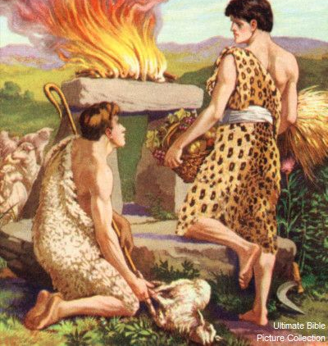
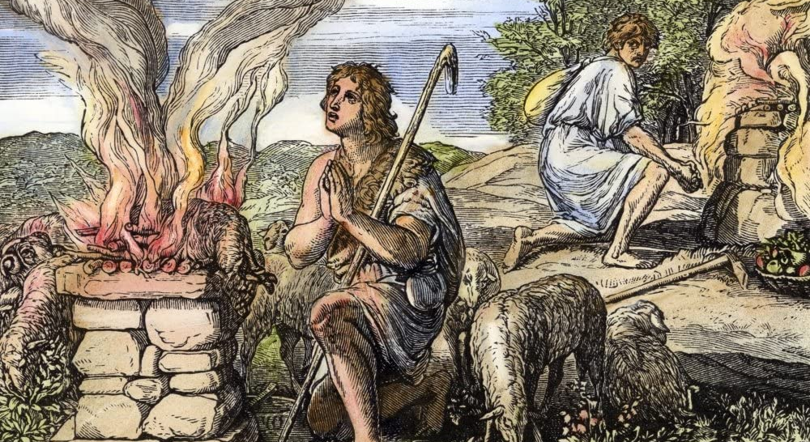
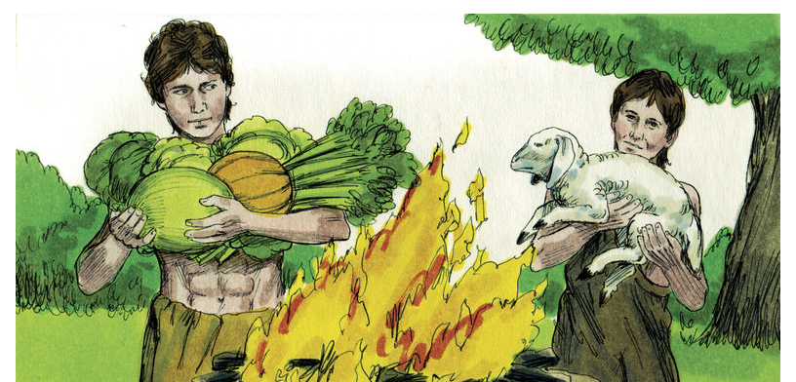

Slide 64
“So he drove out the man; and he placed at the east of the garden of Eden Cherubims, and a flaming sword which turned every way, to keep the way of the tree of life.”
Genesis 3:22-24

Slide 66
“And there I will meet with thee, and I will commune with thee from above the mercy seat, from between the two cherubims which are upon the ark of the testimony…”
Exodus 25:22

Slide 68
“And Cain talked with Abel his brother: and it came to pass, when they were in the field, that Cain rose up against Abel his brother, and slew him.”
~ Genesis 4:8

Slide 69
“And now art thou cursed from the earth, which hath opened her mouth to receive thy brother's blood from thy hand; When thou tillest the ground, it shall not henceforth yield unto thee her strength; a fugitive and a vagabond shalt thou be in the earth.”
Genesis 4:11-16

Slide 70
“And Cain said unto the LORD, My punishment is greater than I can bear. Behold, thou hast driven me out this day from the face of the earth; and from thy face shall I be hid; and I shall be a fugitive and a vagabond in the earth; and it shall come to pass, that every one that findeth me shall slay me.”
Genesis 4:11-16

Slide 71
“And the LORD said unto him, Therefore whosoever slayeth Cain, vengeance shall be taken on him sevenfold. And the LORD set a mark upon Cain, lest any finding him should kill him. And Cain went out from the presence of the LORD…”
Genesis 4:11-16

Slide 72
The Mark of Cain
Translated from the Hebrew “oth” (beacon or signal).
Placed upon Cain for his own benefit and protection, not as a punishment.
Did not pass to his children.

Slide 73
“And Cain went out from the presence of the LORD, and dwelt in the land of Nod, on the east of Eden. And Cain knew his wife; and she conceived, and bare Enoch: and he builded a city, and called the name of the city, after the name of his son, Enoch.”
Genesis 4:16-17

Slide 74
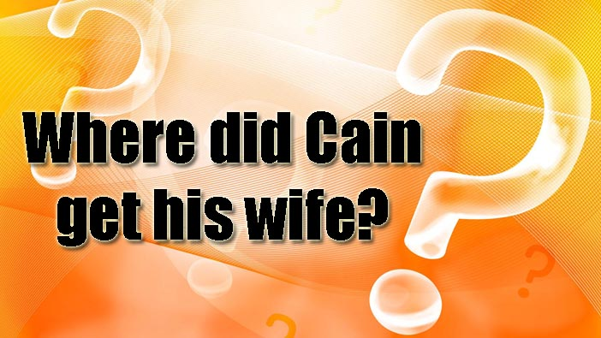
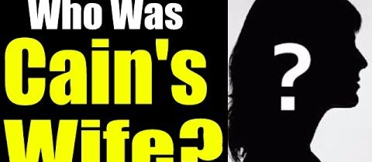
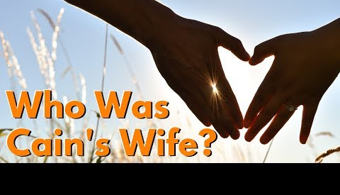

Slide 75
Cain’s Wife?
Cain married a sister or niece.

Slide 76
“And Adam lived an hundred and thirty years, and begat a son in his own likeness, after his image; and called his name Seth: And the days of Adam after he had begotten Seth were eight hundred years: and he begat sons and daughters: And all the days that Adam lived were nine hundred and thirty years: and he died.”
Genesis 5:3-5

Slide 77
Cain’s Wife?
Cain married a sister or niece.
No health risks due to absence of genetic mutations.

Slide 79
Cain’s Wife?
Cain married a sister or niece.
No health risks due to absence of genetic mutations.
Marriage to close family members was not prohibited until the time of Moses (Leviticus 18)

Slide 80
Paradise and the Pre-Flood World
The Garden of Eden
The Plan of God
The Fall of Man
The Eastern Gate
The Pre-Flood World

Slide 81
“And Adam lived an hundred and thirty years, and begat a son in his own likeness, after his image; and called his name Seth: And the days of Adam after he had begotten Seth were eight hundred years: and he begat sons and daughters: And all the days that Adam lived were nine hundred and thirty years: and he died.”
Genesis 5:3-5

Slide 82
“And Seth lived an hundred and five years, and begat Enos: And Seth lived after he begat Enos eight hundred and seven years, and begat sons and daughters: And all the days of Seth were nine hundred and twelve years: and he died.”
Genesis 5:6-8

Slide 83
Pre-Flood Lifespans
Adam 930
Seth 912
Enos 905
Cainan 910
Mahalaleel 895
Jared 962
Enoch 365
Methuselah 969
Lamech 777
Noah 950
Average lifespan = 912 years
(78.7 years today)

Slide 85
A tremendous amount of knowledge was available with this many generations alive at the same time!

Slide 86
People were able to have children for a much longer period as well.
Enoch (65 years)
Noah (500 years)

Slide 88
“And Pharaoh said unto Jacob, How old art thou? And Jacob said unto Pharaoh, The days of the years of my pilgrimage are an hundred and thirty years: few and evil have the days of the years of my life been, and have not attained unto the days of the years of the life of my fathers in the days of their pilgrimage.”
Genesis 47:8-9

Slide 90
Reasons for Lifespan Reduction
Increase of genetic mutations
Dietary changes
Environmental changes

Slide 92
Aging is determined by the body’s ability to maintain, repair, and protect itself.

Slide 94
A decrease in the efficiency of our genetic repair system will lead to more rapid aging and decreased lifespans.

Slide 95
Still today, ~90% of the human body does not continue to get older.

Slide 96
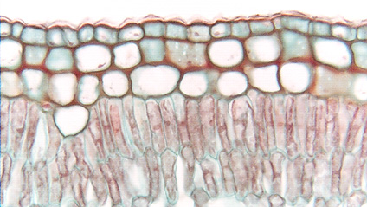
The epidermal cells in our skin never get older than one month.

Slide 97
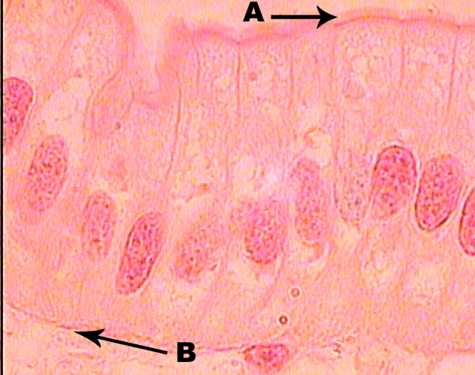
The epithelial tissue and cells lining the small intestine regenerate every four days.

Slide 98
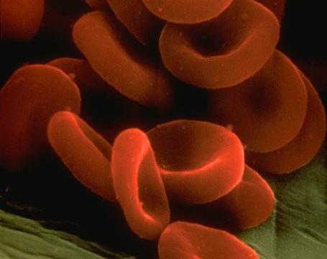
Our red blood cells are replaced every 90 days.

Slide 99
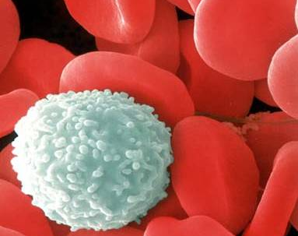
Our white blood cells are replaced every week.

Slide 101
“There shall be no more thence an infant of days, nor an old man that hath not filled his days: for the child shall die an hundred years old…”
Isaiah 65:20

Slide 102
Paradise and the Pre-Flood World
The Garden of Eden
The Plan of God
The Fall of Man
The Eastern Gate
The Pre-Flood World
The Initiation of Prayer

Slide 103
“And Adam knew his wife again; and she bare a son, and called his name Seth: For God, said she, hath appointed me another seed instead of Abel, whom Cain slew. And to Seth, to him also there was born a son; and he called his name Enos: then began men to call upon the name of the LORD.”
Genesis 4:25-26

Slide 104
“For whosoever shall call upon the name of the Lord shall be saved.”
Romans 10:13

Slide 105
235 years

Slide 106
The Garden of Eden
From Creation to Eden’s Gate
By Stephen Lawwell
Foundations of Genesis: Part 2

