Slide 1
The Genesis Flood
Evidence and Implications of the Worldwide Catastrophe
By Stephen Lawwell
Foundations of Genesis: Part 3

Slide 2
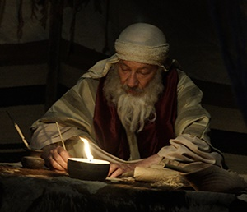
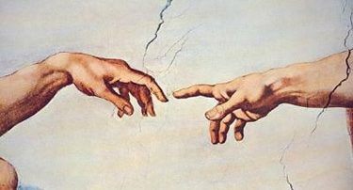
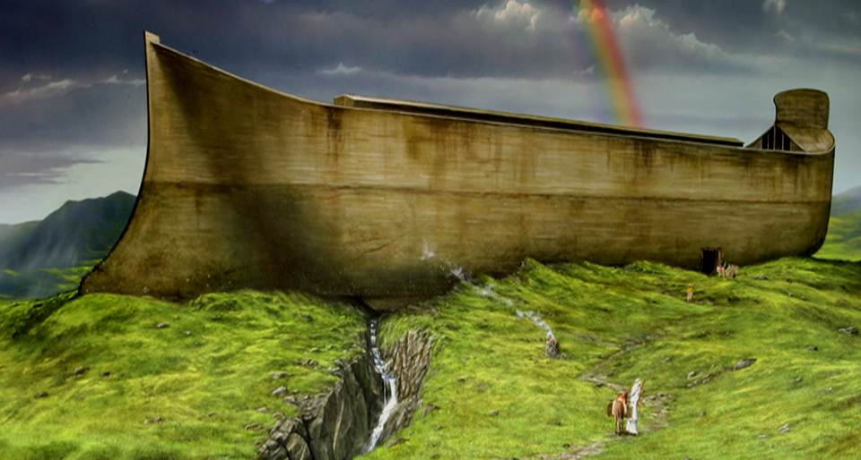
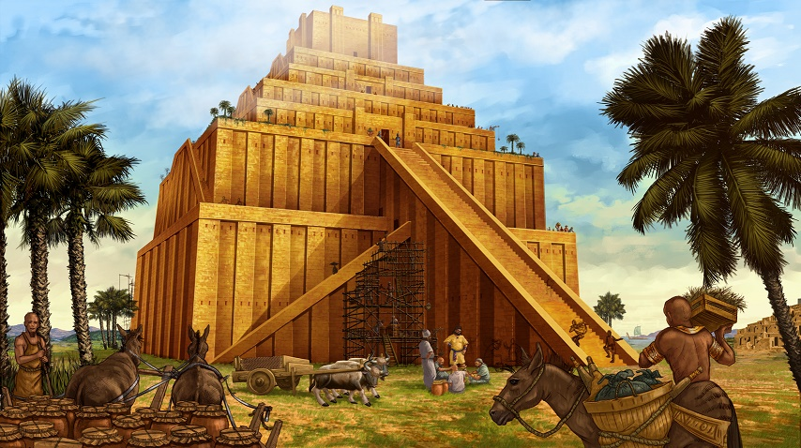

Slide 3
“If the foundations be destroyed, what can the righteous do?”
Psalm 11:3

Slide 4
The Ark was not big enough to hold all of those animals!
It could not rain enough in 40 days to flood the Earth!
No wooden ship the size of the Ark could have survived the turbulent floodwaters!
The Genesis Flood account is a myth derived from Sumerian legends!

Slide 5
“Knowing this first, that there shall come in the last days scoffers, walking after their own lusts,… For this they willingly are ignorant of, that by the word of God the heavens were of old, and the earth standing out of the water and in the water: Whereby the world that then was, being overflowed with water, perished:”
2 Peter 3:3-6

Slide 6
The Genesis Flood
The Pre-Flood Society

Slide 7
“And GOD saw that the wickedness of man was great in the earth, and that every imagination of the thoughts of his heart was only evil continually. And it repented the LORD that he had made man on the earth, and it grieved him at his heart.”
Genesis 6:5-7

Slide 8
“And the LORD said, I will destroy man whom I have created from the face of the earth; both man, and beast, and the creeping thing, and the fowls of the air; for it repenteth me that I have made them.”
Genesis 6:5-7

Slide 9
“…all flesh had corrupted his way upon the earth.”
Genesis 6:12

Slide 10
“And as it was in the days of Noe, so shall it be also in the days of the Son of man. They did eat, they drank, they married wives, they were given in marriage, until the day that Noe entered into the ark, and the flood came, and destroyed them all.”
Luke 17:26-27

Slide 11
“But Noah found grace in the eyes of the LORD.”
Genesis 6:8

Slide 12
480

Slide 13
Methusaleh
(“when he dies, it shall come or be sent”)

Slide 14
“…Noah the eighth person, a preacher of righteousness…”
2 Peter 2:5

Slide 15
“Knowing therefore the terror of the Lord, we persuade men;”
2 Corinthians 5:11

Slide 16
“And Noah was five hundred years old: and Noah begat Shem, Ham, and Japheth.”
Genesis 5:32

Slide 17
The Genesis Flood
The Pre-Flood Society
The Ark

Slide 18
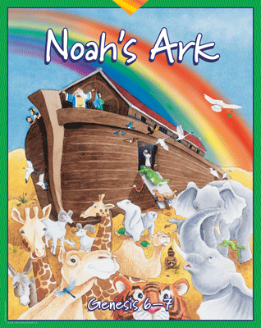

Slide 19
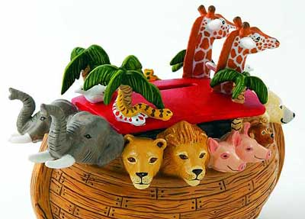

Slide 20
How Big Was The Ark?
300 x 50 x 30 cubits
(Genesis 6:15)

Slide 23
Royal Egyptian Cubit

Slide 24
440 x 73.33 x 44 feet
(Shorter Egyptian cubit of 17.6 inches)

Slide 25
515 x 85.83 x 51.5 feet
(Longer Egyptian cubit of 20.6 inches)

Slide 26
Three Decks
(Genesis 6:16)

Slide 27
“And of every living thing of all flesh, two of every sort shalt thou bring into the ark, to keep them alive with thee; they shall be male and female. Of fowls after their kind, and of cattle after their kind, of every creeping thing of the earth after his kind, two of every sort shall come unto thee, to keep them alive.”
Genesis 6:19-20

Slide 29
Canis familiaris (dog)
Canis lestes (coyote)
Canis lupus (wolf)

Slide 33
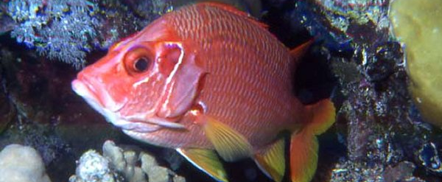
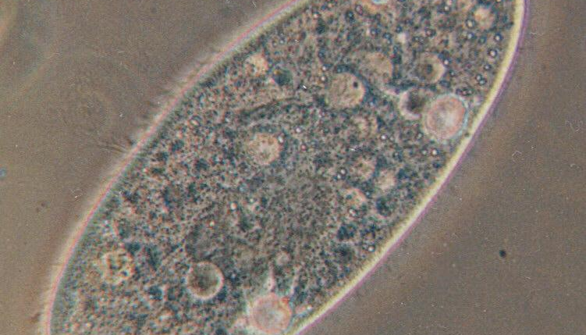
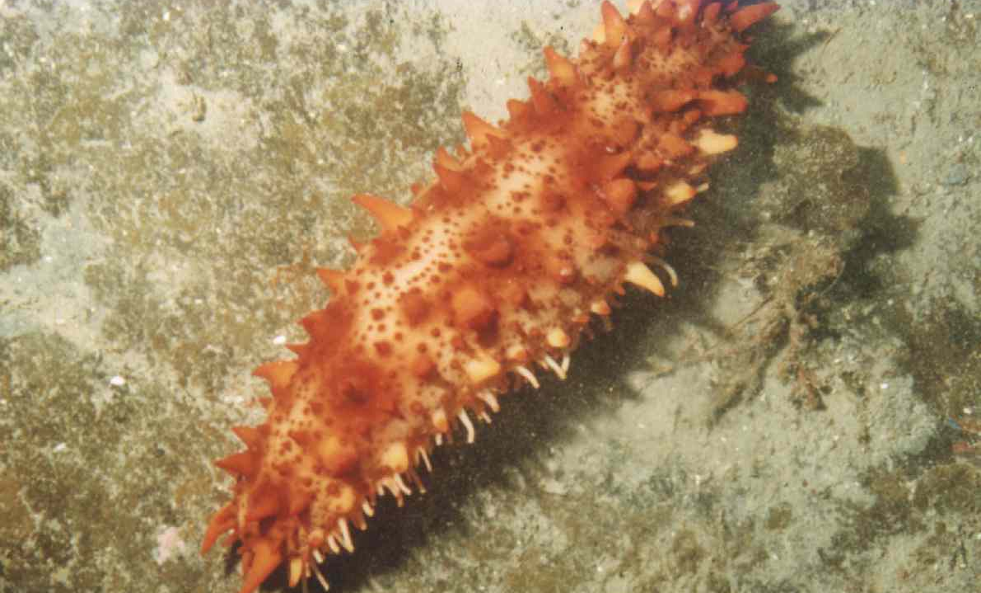

Slide 34
~6,700 animals

Slide 35
440 x 73.33 x 44 feet
(Shorter Egyptian cubit of 17.6 inches)

Slide 36
Only 11% of the animals were larger than a sheep.
The Ark’s capacity was equivalent to 520 railroad stock cars, each with the capacity to carry 240 sheep.
The Ark was large enough to carry 124,800 sheep-sized animals.

Slide 37
1
6
Length to Breadth Ratio

Slide 38
The Genesis Flood
The Pre-Flood Society
The Ark
The Fountains of the Great Deep

Slide 39
“Where wast thou when I laid the foundations of the earth? declare, if thou hast understanding… Whereupon are the foundations thereof fastened? or who laid the corner stone thereof;”
Job 38:4,6

Slide 40
“…for the pillars of the earth are the LORD'S, and he hath set the world upon them.”
1 Samuel 2:8

Slide 41
http://www.creationscience.com/onlinebook/HydroplateOverview4.html

Slide 42
5 miles
30 miles

Slide 43
“When he established the clouds above: when he strengthened the fountains of the deep:”
Proverbs 8:28

Slide 44
http://www.creationscience.com/onlinebook/HydroplateOverview4.html

Slide 45
Kola Superdeep Borehole
“To the surprise of the researchers, they did not find the expected transition from granite to basalt at 3-6 kilometers beneath the surface… Even more surprisingly, this deep rock was found to be saturated in water which filled the cracks. Because free water should not be found at those depths, scientists theorize that the water is comprised of hydrogen and oxygen atoms which were squeezed out of the surrounding rocks due to the incredible pressure. The water was then prevented from rising to the surface because of the layer of impermeable rocks above it.”
Alan Bellows, The Most Boring Story Ever Told (June 20, 2006)

Slide 47
“In the six hundredth year of Noah's life, in the second month, the seventeenth day of the month, the same day were all the fountains of the great deep broken up, and the windows of heaven were opened.”
Genesis 7:11-12

Slide 48
“And the rain was upon the earth forty days and forty nights.”
Genesis 7:11-12

Slide 49
Walt Brown, In the Beginning Seventh Edition, p. 101

Slide 50
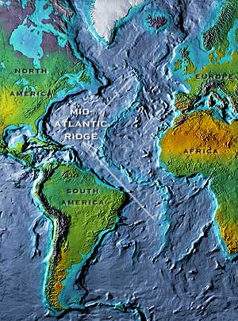
www.pbs.org/odyssey/images/20050530_daily2_b.jpg

Slide 51
World Ocean Floor, Bruce C. Heezen and Marie Tharp (1977)

Slide 52
Walt Brown, In the Beginning Seventh Edition, p. 101

Slide 53
RAIN
RAIN
RAIN
RAIN
RAIN
RAIN
RAIN
RAIN
RAIN
RAIN
RAIN
RAIN
Walt Brown, In the Beginning Seventh Edition, p. 101

Slide 54
“And the rain was upon the earth forty days and forty nights.”
Genesis 7:12

Slide 55
The Genesis Flood
The Pre-Flood Society
The Ark
The Fountains of the Great Deep
The End of All Flesh

Slide 56
“And all flesh died that moved upon the earth, both of fowl, and of cattle, and of beast, and of every creeping thing that creepeth upon the earth, and every man: All in whose nostrils was the breath of life, of all that was in the dry land, died… and Noah only remained alive, and they that were with him in the ark.”
Genesis 7:21-23

Slide 57
“Whereby the world that then was, being overflowed with water, perished:”
~ 2 Peter 3:6

Slide 61
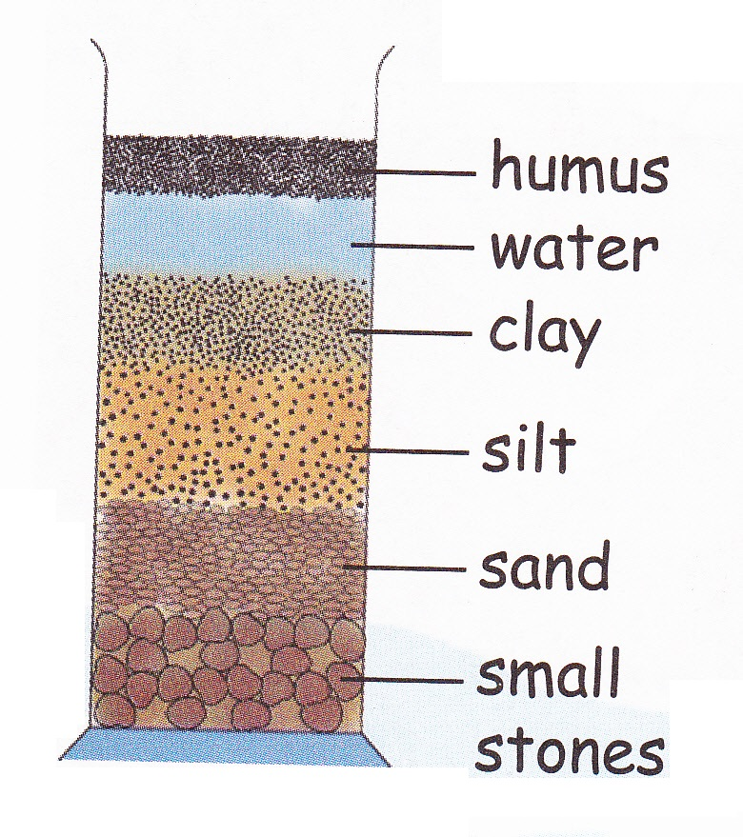
Hydraulic Sorting of Sediment

Slide 64
STRATA

Slide 66
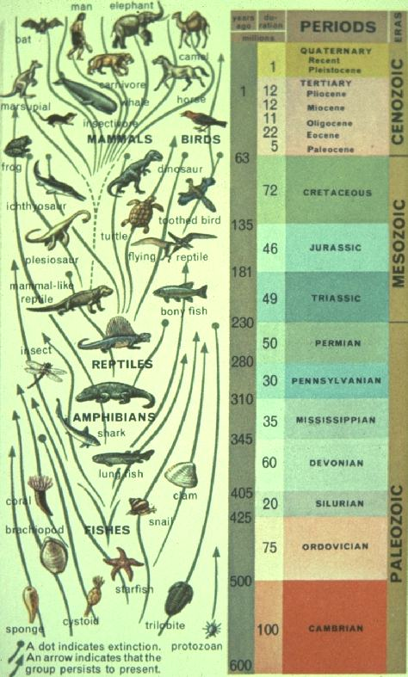
Factors of Burial
Elevation

Slide 67
Land Dwellers
Aquatic

Slide 68
Factors of Burial
Elevation
Mobility

Slide 69
More Mobile
Less Mobile

Slide 70
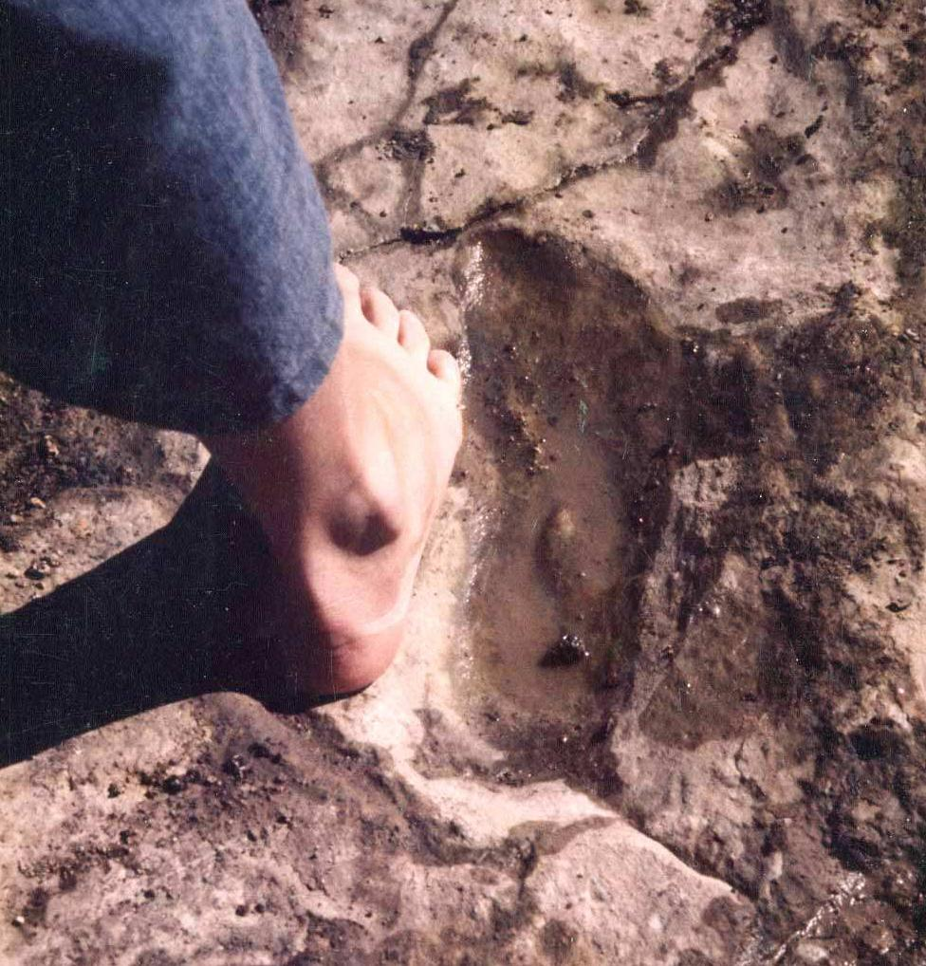
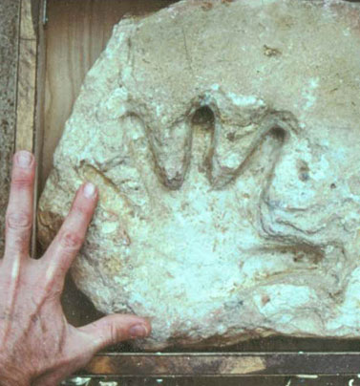

Slide 71
Factors of Burial
Elevation
Mobility
Density

Slide 72
Less Dense
More Dense

Slide 73
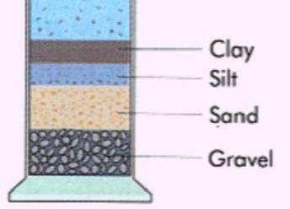

Slide 76
Factors of Burial
Elevation
Mobility
Density
Intelligence

Slide 77
More Intelligent
Less Intelligent

Slide 83
Scientific American, (June 1851)
p. 289-299
Blasted out of solid rock dated to be over 600 million years old in Dorchester, MA.

Slide 84
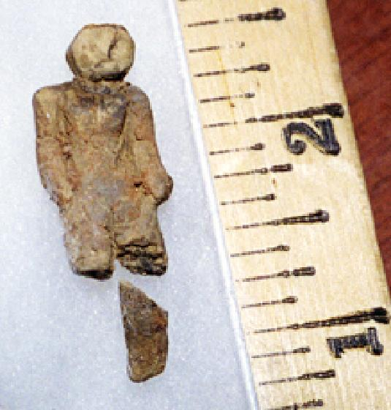
Clay doll found in Nampa, Idaho at a depth of 320 feet, in a rock layer believed to be twelve million years old.

Slide 85
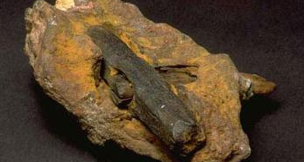
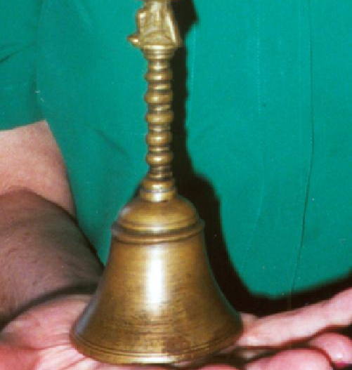
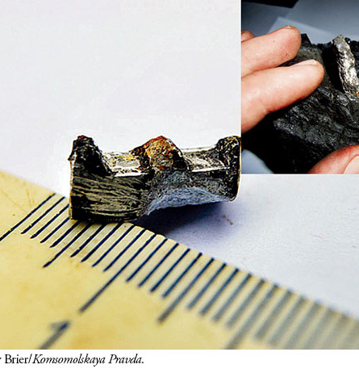
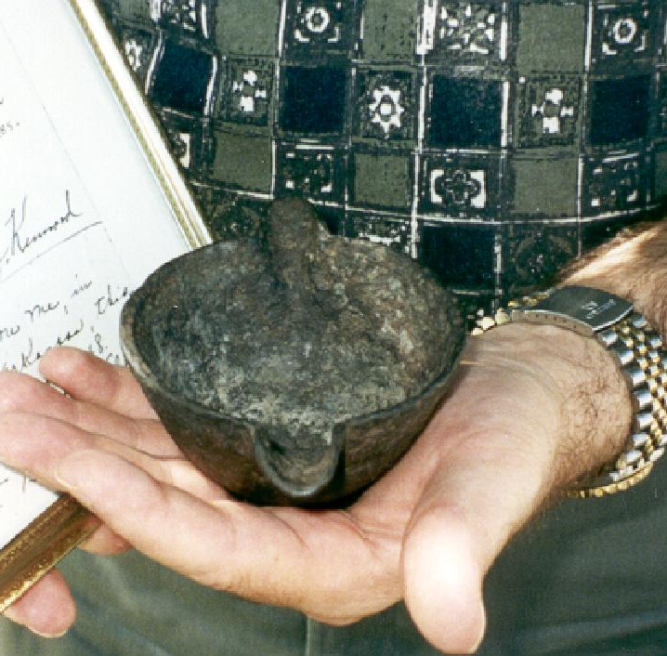

Slide 87
The Genesis Flood
The Pre-Flood Society
The Ark
The Fountains of the Great Deep
The End of All Flesh
The Flood Subsides

Slide 88
“And God remembered Noah, and… made a wind to pass over the earth, and the waters asswaged; The fountains also of the deep and the windows of heaven were stopped, and the rain from heaven was restrained; And the waters returned from off the earth continually…”
Genesis 8:1-3

Slide 89
“They go up by the mountains; they go down by the valleys unto the place which thou hast founded for them. Thou hast set a bound that they may not pass over; that they turn not again to cover the earth.”
Psalm 104:8-9

Slide 90
Walt Brown, In the Beginning Seventh Edition, p. 103

Slide 91
Walt Brown, In the Beginning Seventh Edition, p. 103

Slide 92
Walt Brown, In the Beginning Seventh Edition, p. 103

Slide 94
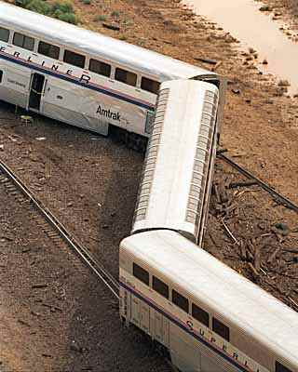
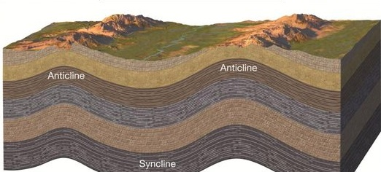
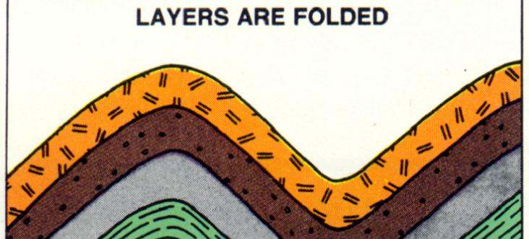

Slide 96
Geologic Survey of Canada (GSC180345)

Slide 99
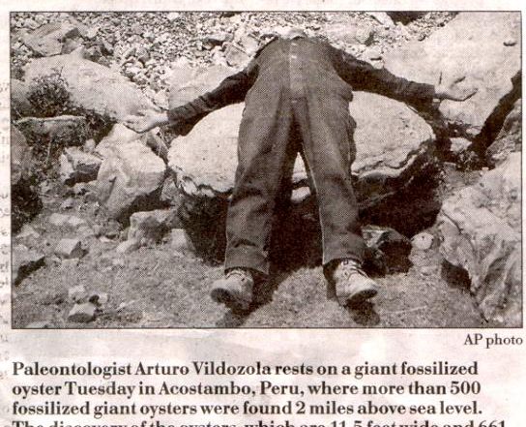
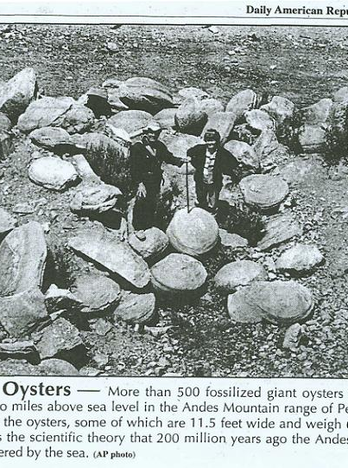

Slide 100
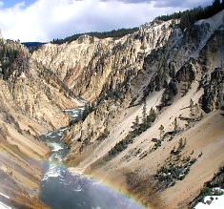
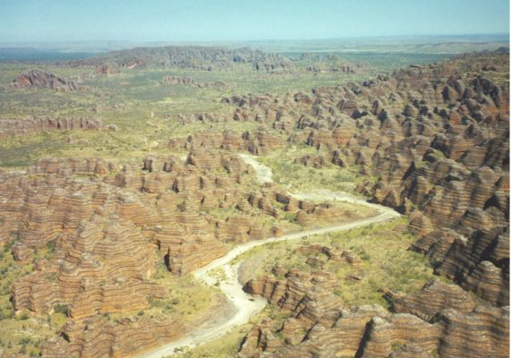
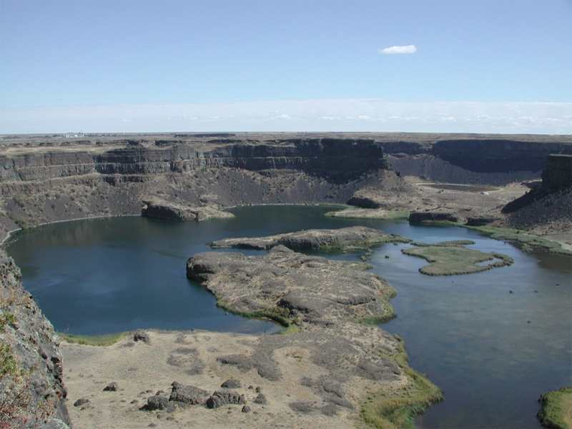

Slide 101
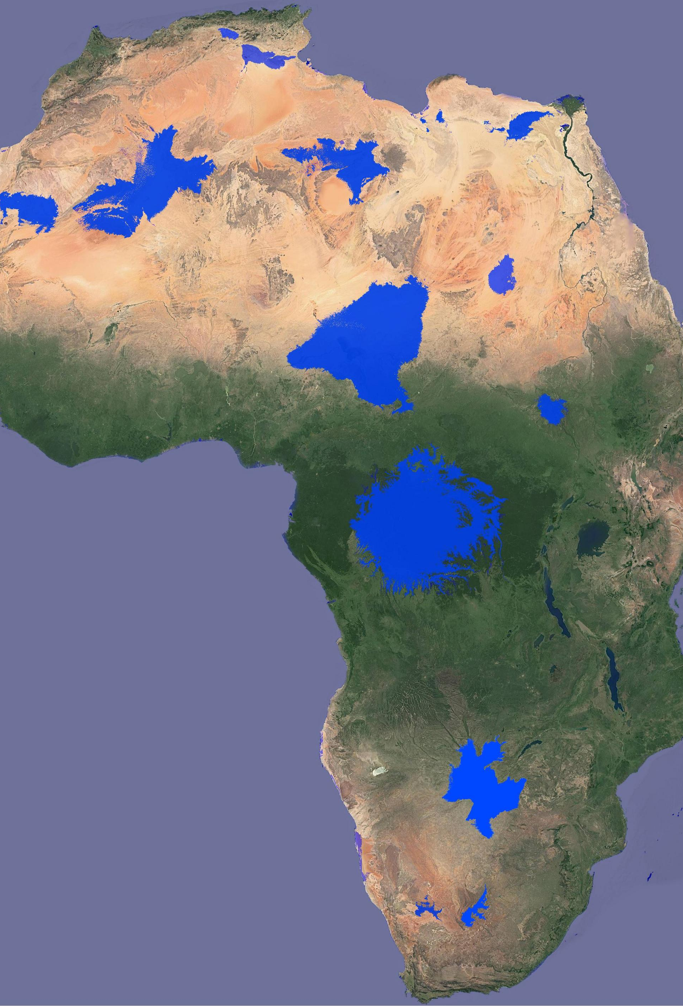
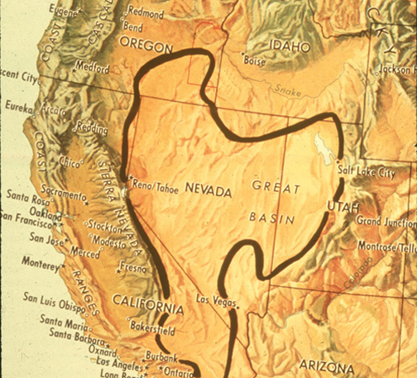

Slide 102
Escalante Petrified Forest of Utah
Petrified Forest of Arizona

Slide 105
The Genesis Flood
The Pre-Flood Society
The Ark
The Fountains of the Great Deep
The End of All Flesh
The Flood Subsides
The Constant Reminder

Slide 106
“Even as Sodom and Gomorrha, and the cities about them in like manner…are set forth for an example, suffering the vengeance of eternal fire.”
Jude 1:7

Slide 107
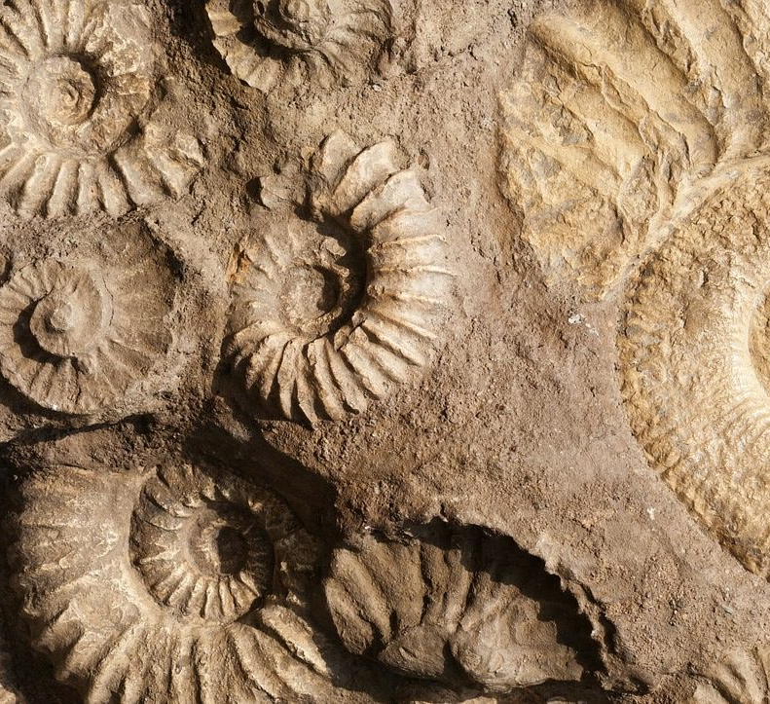
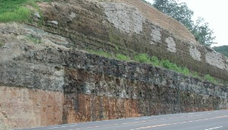

Slide 108
“Knowing therefore the terror of the Lord, we persuade men;”
2 Corinthians 5:11

Slide 109
“And Lamech lived after he begat Noah five hundred ninety and five years, and begat sons and daughters:”
Genesis 5:30

Slide 110
“If sinners will be damned, at least let them leap to hell over our bodies, and if they perish, let them perish with our arms around their knees imploring them to stay. If hell must be filled, at least let it be filled in the teeth of our exertions, and let no one go there unwarned or unprayed for.”
Charles Haddon Spurgeon, 1860 Sermon at Exeter Hall

Slide 111
The Genesis Flood
Evidence and Implications of the Worldwide Catastrophe
By Stephen Lawwell
Foundations of Genesis: Part 3

