Slide 1
In Six Days
Reflections on the Creation Week
By Stephen Lawwell
Foundations of Genesis: Part 1

Slide 2
“I applied mine heart to know, and to search, and to seek out wisdom, and the reason of things…”
Ecclesiastes 7:25

Slide 3
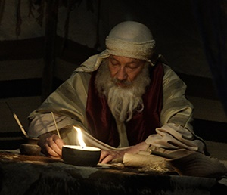
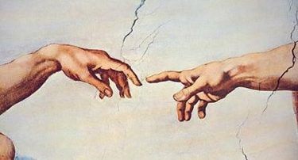
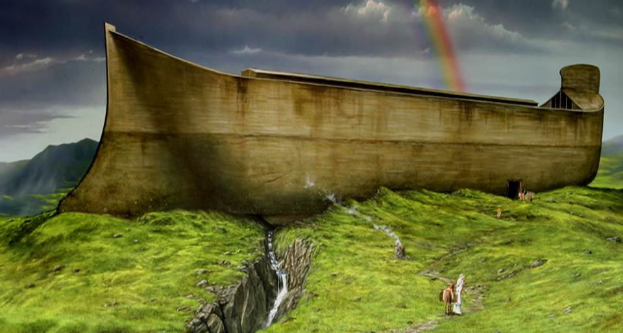
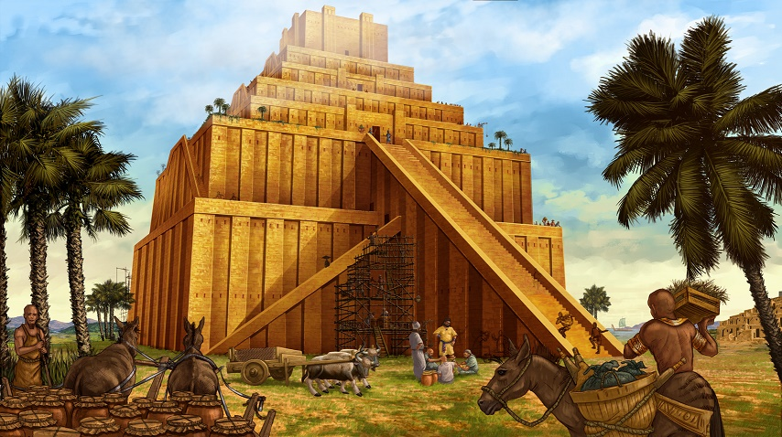

Slide 4
The Significance of Genesis
There are at least 165 passages in Genesis that are directly quoted or referenced in the New Testament, with over 100 of these from the first eleven chapters of Genesis.

Slide 5
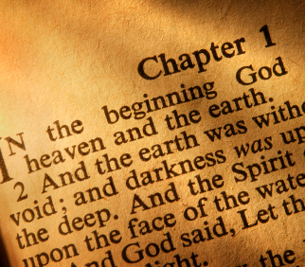
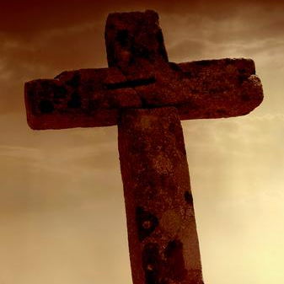

Slide 6
The starting point of the Christian faith is Genesis 1:1, not Matthew 1:1.

Slide 7
“If the foundations be destroyed, what can the righteous do?”
Psalm 11:3

Slide 8
“He who surrenders the first page of his Bible, surrenders all. He knows not where to stop. Nay, you and I cannot in any way afford to surrender the beginning of Genesis… It is not too much to say that the beginning of Genesis is the foundation on which all the rest of the Bible is built.”
John William Burgon, Inspiration and Interpretation (1861), p. 50-51

Slide 9
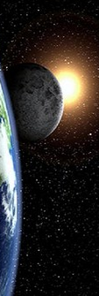
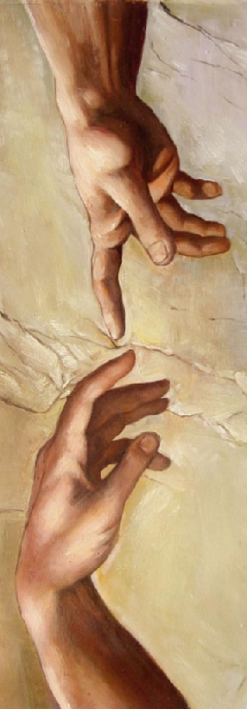
1
2
3
4
5
6

Slide 10
“In the beginning God created the heaven and the earth.”
Genesis 1:1

Slide 12
“For the invisible things of him from the creation of the world are clearly seen, being understood by the things that are made, even his eternal power and Godhead; so that they are without excuse...”
Romans 1:20

Slide 13
“In the beginning God created the heaven and the earth.”
(TIME)
Genesis 1:1

Slide 14
“In the beginning God created the heaven and the earth.”
(SPACE)
Genesis 1:1

Slide 15
“In the beginning God created the heaven and the earth.”
(MATTER)
Genesis 1:1

Slide 16
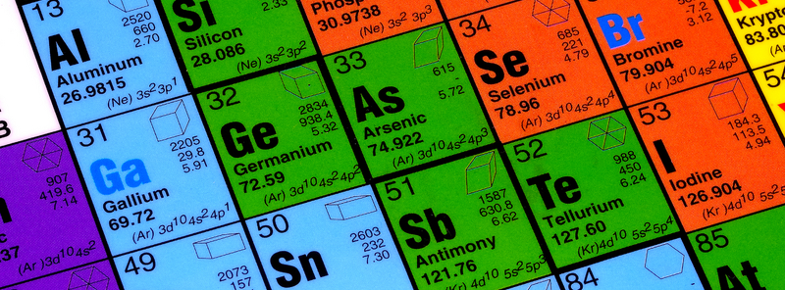
CONTINUUM

Slide 17
UNIVERSE
TIME
SPACE
MATTER

Slide 18
UNIVERSE
TIME
SPACE
MATTER

Slide 19
GOD
FATHER
SON
HOLY SPIRIT

Slide 20
How can three things completely make up something and still be one?
+
+
1 1 1 = 3

Slide 21
How can three things completely make up something and still be one?
x
x
1
1 1 1 =

Slide 22
FUTURE
PRESENT
PAST

Slide 23
HEIGHT
WIDTH
DEPTH

Slide 24
LIQUID
GAS
SOLID

Slide 25
SOLID
GENESIS 1:1
MATTER
“THE TRINITY OF TRINITIES”
LIQUID
GAS
HEIGHT
PAST
SPACE
TIME
WIDTH
DEPTH
PRESENT
FUTURE

Slide 26
“And the earth was without form, and void; and darkness was upon the face of the deep. And the Spirit of God moved upon the face of the waters. And God said, Let there be light: and there was light.”
Genesis 1:2-3

Slide 28
“And the Spirit of God moved upon the face of the waters…”
rachaph
“To move, shake, vibrate, or flutter.”

Slide 30
1
2
3
4
5
6

Slide 31
“And God said, Let there be a firmament in the midst of the waters, and let it divide the waters from the waters. And God made the firmament, and divided the waters which were under the firmament from the waters which were above the firmament: and it was so. And God called the firmament Heaven.”
Genesis 1:6-8

Slide 32
“...and fowl that may fly above the earth in the open firmament of heaven.”
Genesis 1:20

Slide 33
“Praise him, ye heavens of heavens, and ye waters that be above the heavens.”
Psalm 148:4

Slide 34
“I knew a man in Christ… such an one caught up to the third heaven.”
2 Corinthians 12:2

Slide 35
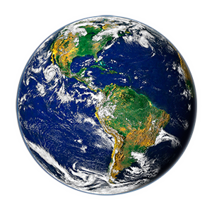

Slide 36
“In the beginning God created the heaven and the earth.”
Genesis 1:1

Slide 37
“Thus the heavens and the earth were finished, and all the host of them.”
Genesis 2:1

Slide 38
1
2
3
4
5
6

Slide 39
“And God said, Let the waters under the heaven be gathered together unto one place, and let the dry land appear: and it was so. And God called the dry land Earth; and the gathering together of the waters called he Seas:”
Genesis 1:9-10

Slide 41
“Where wast thou when I laid the foundations of the earth? declare, if thou hast understanding… Whereupon are the foundations thereof fastened? or who laid the corner stone thereof;”
Job 38:4,6

Slide 42
“…for the pillars of the earth are the LORD'S, and he hath set the world upon them.”
1 Samuel 2:8

Slide 43
“Which shaketh the earth out of her place, and the pillars thereof tremble.”
Job 9:6

Slide 44
http://www.creationscience.com/onlinebook/HydroplateOverview4.html

Slide 45
5 miles
30 miles

Slide 46
“When he established the clouds above: when he strengthened the fountains of the deep:”
Proverbs 8:28

Slide 47
http://www.creationscience.com/onlinebook/HydroplateOverview4.html

Slide 48
“And the earth brought forth grass, and herb yielding seed after his kind, and the tree yielding fruit, whose seed was in itself, after his kind: and God saw that it was good.”
Genesis 1:12

Slide 50
“Can the fig tree, my brethren, bear olive berries? either a vine, figs?”
James 3:12

Slide 51
English Walnut tree grafted on a
Black Walnut stump
(Red Bluff, CA)

Slide 52
“…and God saw that it was good.”
~ Genesis 1:12

Slide 53
1
2
3
4
5
6

Slide 54
“And God said, Let there be lights in the firmament of the heaven to divide the day from the night; and let them be for signs, and for seasons, and for days, and years: And let them be for lights in the firmament of the heaven to give light upon the earth: and it was so.”
Genesis 1:14-18

Slide 55
“And God made two great lights; the greater light to rule the day, and the lesser light to rule the night: he made the stars also. And God set them in the firmament of the heaven to give light upon the earth, And to rule over the day and over the night, and to divide the light from the darkness: and God saw that it was good.”
Genesis 1:14-18

Slide 56
“Light Givers”

Slide 57
“And the city had no need of the sun, neither of the moon, to shine in it: for the glory of God did lighten it, and the Lamb is the light thereof.”
Revelation 21:23

Slide 58
“When I consider thy heavens, the work of thy fingers, the moon and the stars, which thou hast ordained;”
~ Psalm 8:3

Slide 59
Have you considered that moonlight is light from the sun that is reflected off the moon’s silica and quartz surface?

Slide 60
Have you considered that the moon is the exact distance from the earth to make it appear to be the same size as the sun?

Slide 61
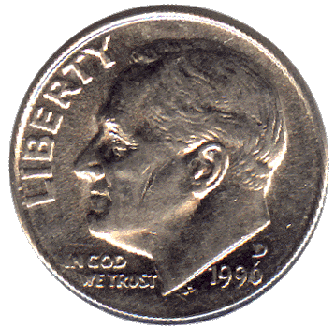
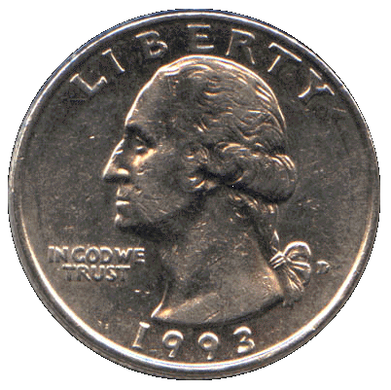

Slide 62
How Big Is God?

Slide 65
Traveling at 60 mph, how long would it take to travel from the earth to the moon?
165 days!

Slide 66
~93,000,000 miles = 1 Astronomical Unit (AU)

Slide 67
150 years!
Traveling at 60 mph, how long would it take to travel from the earth to the sun?

Slide 68
Traveling at 60 mph, how long would it take to travel from the earth to Pluto?
6,000 years!

Slide 70
Speed of Light
~186,000 miles/second

Slide 71
A light year is the distance that light can travel in one year.
5,870,000,000,000 miles

Slide 72
Seven billion miles
10 light hours!

Slide 73
The next closest star to us (Proximus Centauri) is 4.3 light years away.

Slide 74
100 billion stars

Slide 75
100,000 light years

Slide 76
“As the host of heaven cannot be numbered, neither the sand of the sea measured:”
~ Jeremiah 33:22

Slide 77
“…he made the stars also.”
~ Genesis 1:16

Slide 78
“Thus saith the LORD, The heaven is my throne, and the earth is my footstool:”
~ Isaiah 66:1

Slide 79
“…my right hand hath spanned the heavens:”
~ Isaiah 48:13

Slide 81
“The heavens declare the glory of God; and the firmament sheweth his handywork.”
~ Psalm 19:1

Slide 82
1
2
3
4
5
6

Slide 83
“And God said, Let the waters bring forth abundantly the moving creature that hath life, and fowl that may fly above the earth in the open firmament of heaven. And God created great whales, and every living creature that moveth, which the waters brought forth abundantly, after their kind, and every winged fowl after his kind: and God saw that it was good.”
Genesis 1:20-21

Slide 84
http://www.byfocal.com/spindrift/childrens-books/funfacts/funfacts-how-life-evolved-in-the-sea/

Slide 85
“But God giveth it a body as it hath pleased him, and to every seed his own body. All flesh is not the same flesh: but there is one kind of flesh of men, another flesh of beasts, another of fishes, and another of birds.”
1 Corinthians 15:38-39

Slide 87
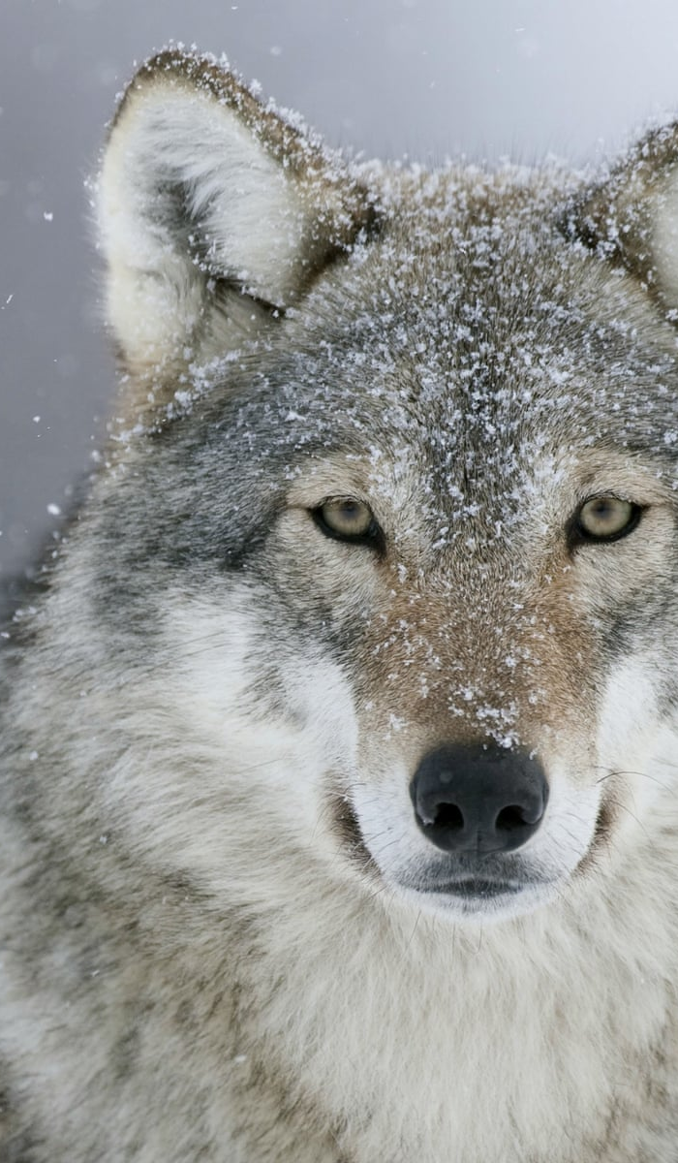
Canis familiaris (dog)
Canis lestes (coyote)
Canis lupus (wolf)

Slide 89
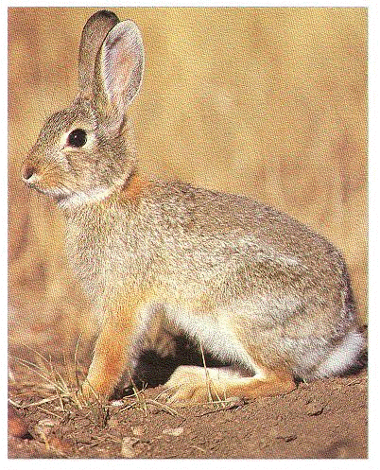
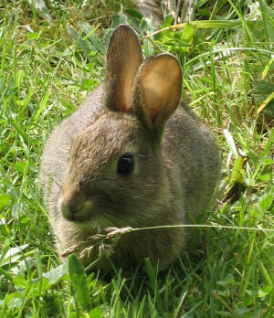
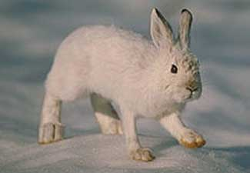
Same Kind?

Slide 90
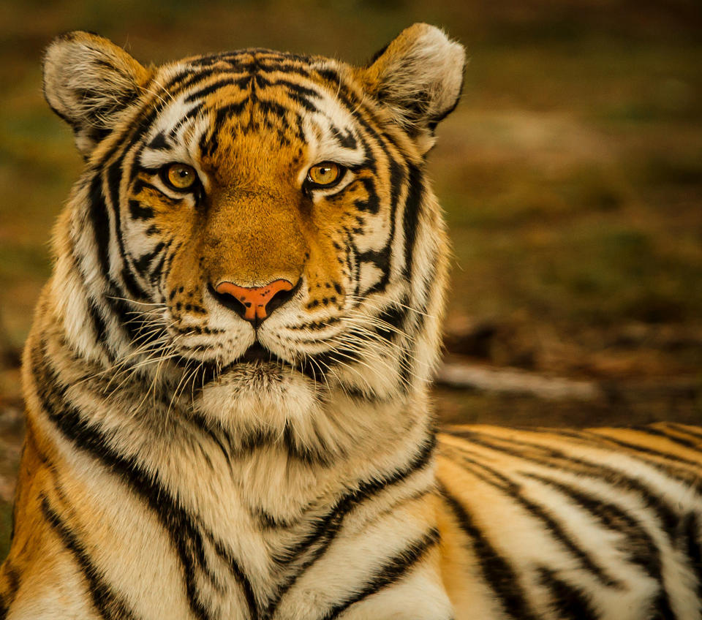
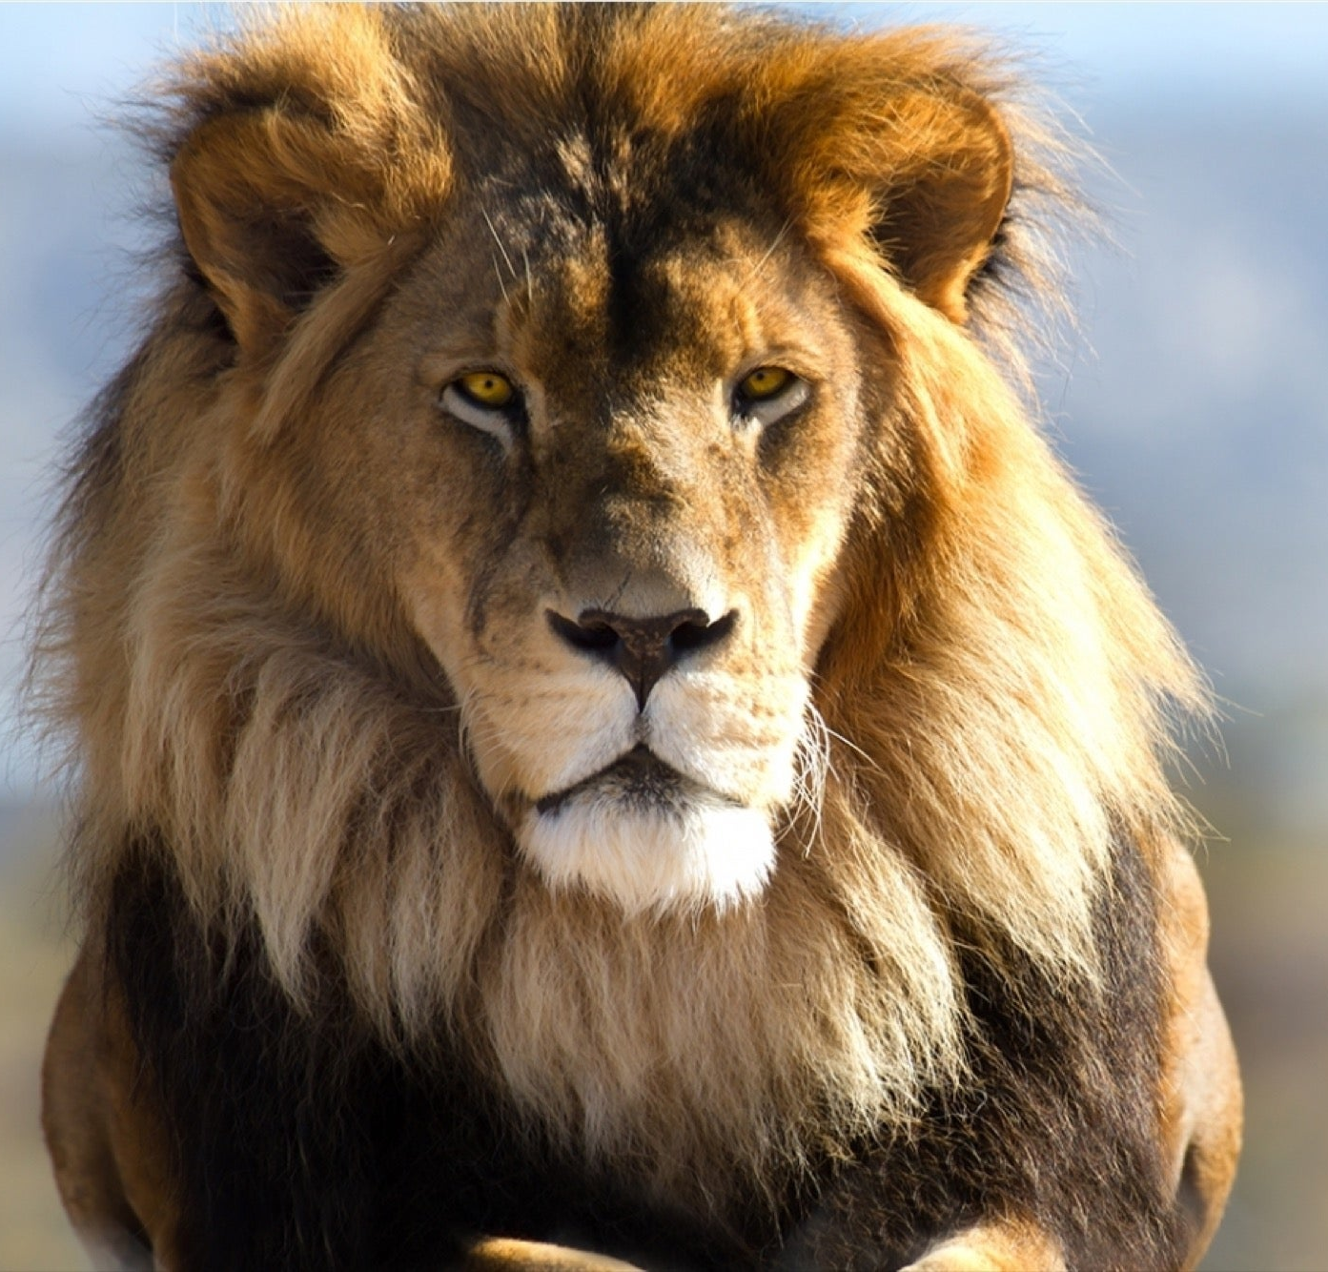

Slide 92
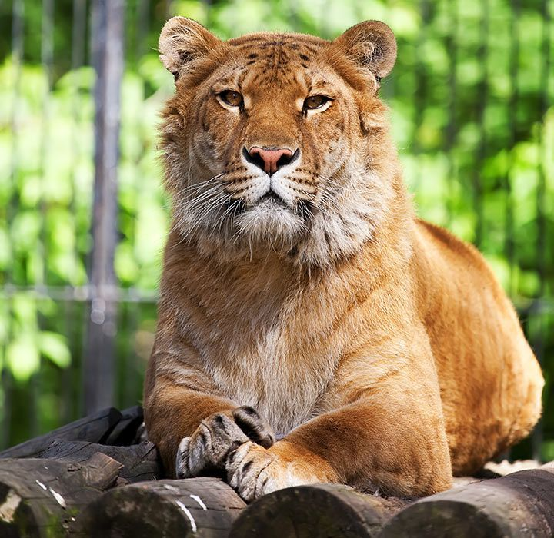
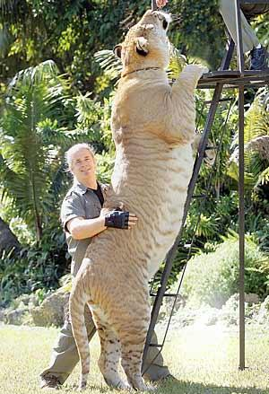
Liger

Slide 93
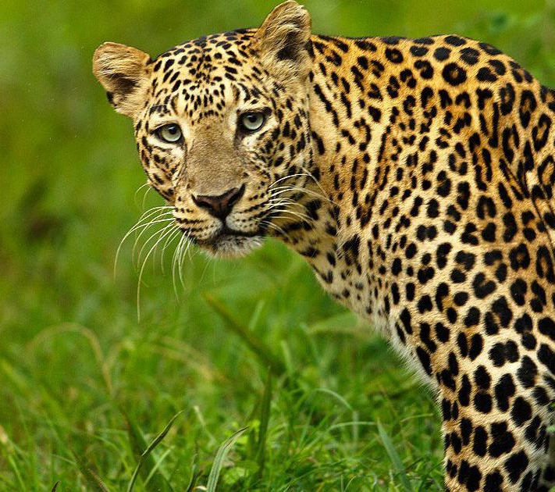

Slide 94
Leopon

Slide 95
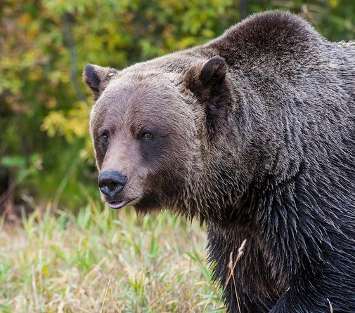
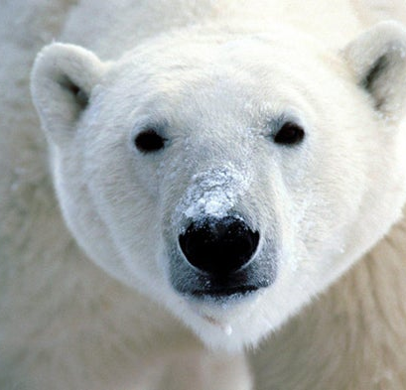

Slide 96
Grolar Bear

Slide 97
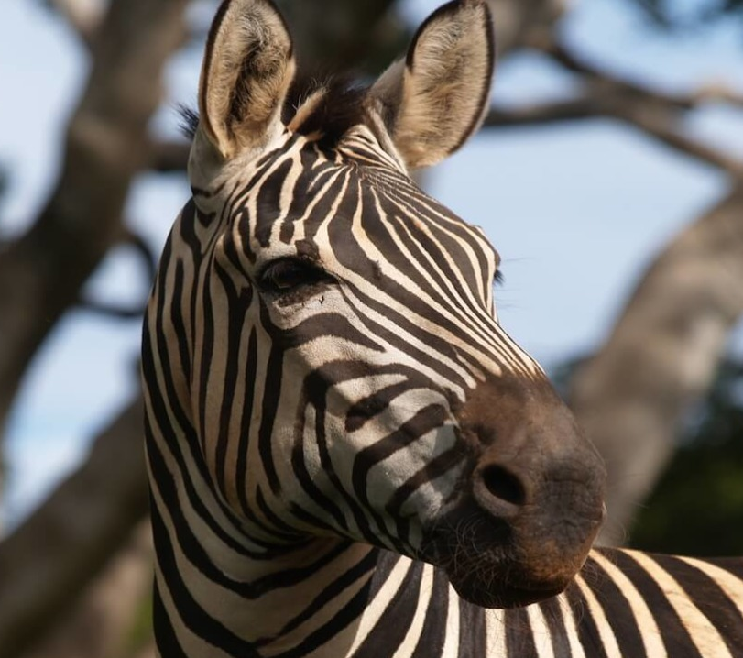
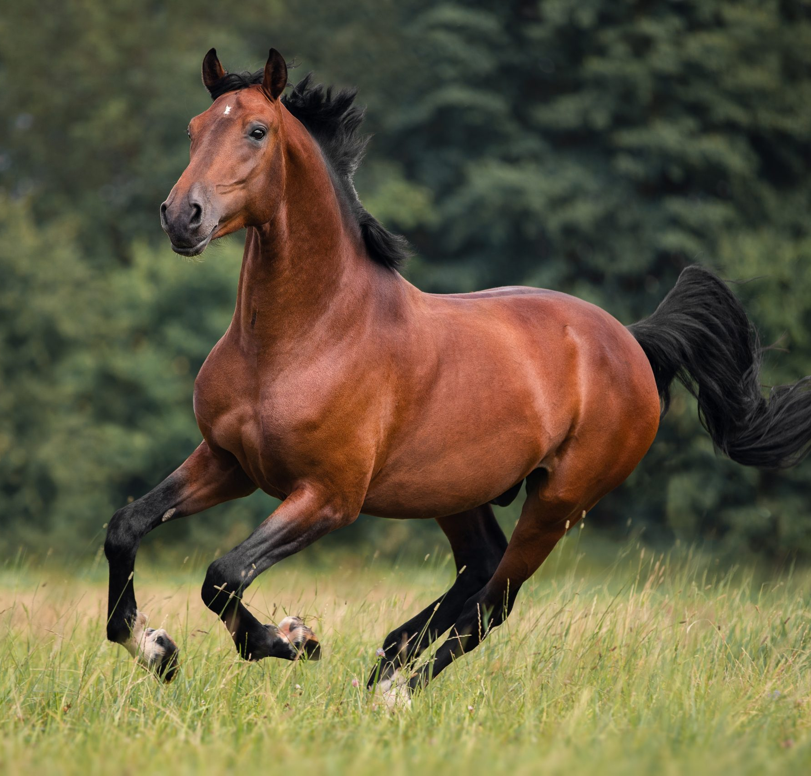

Slide 98
Zorse

Slide 99
1
2
3
4
5
6

Slide 100
“And God said, Let us make man in our image, after our likeness: and let them have dominion over the fish of the sea, and over the fowl of the air, and over the cattle, and over all the earth, and over every creeping thing that creepeth upon the earth. So God created man in his own image, in the image of God created he him; male and female created he them.”
Genesis 1:26-27

Slide 101
“And the LORD God formed man of the dust of the ground, and breathed into his nostrils the breath of life; and man became a living soul.”
Genesis 2:7

Slide 102
ground
“adamah” (Adam)

Slide 103
“And God said, Let the waters bring forth abundantly the moving creature that hath life…”
~ Genesis 1:20
“And God said, Let the earth bring forth the living creature after his kind…”
~ Genesis 1:24
“And God said, Let us make man in our image…”
~ Genesis 1:26

Slide 105
“And the very God of peace sanctify you wholly; and I pray God your whole spirit and soul and body be preserved blameless unto the coming of our Lord Jesus Christ.”
1 Thessalonians 5:23

Slide 106
“Tell us therefore, What thinkest thou? Is it lawful to give tribute unto Caesar, or not? But Jesus perceived their wickedness, and said, Why tempt ye me, ye hypocrites? Shew me the tribute money. And they brought unto him a penny. And he saith unto them, Whose is this image and superscription? They say unto him, Caesar's. Then saith he unto them, Render therefore unto Caesar the things which are Caesar's; and unto God the things that are God's.”
Matthew 22:17-21

Slide 107
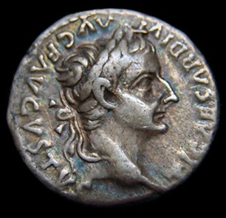
Whose image do people see when they look at your life?

Slide 108
In Six Days
Reflections on the Creation Week
By Stephen Lawwell
Foundations of Genesis: Part 1

